Slide 1
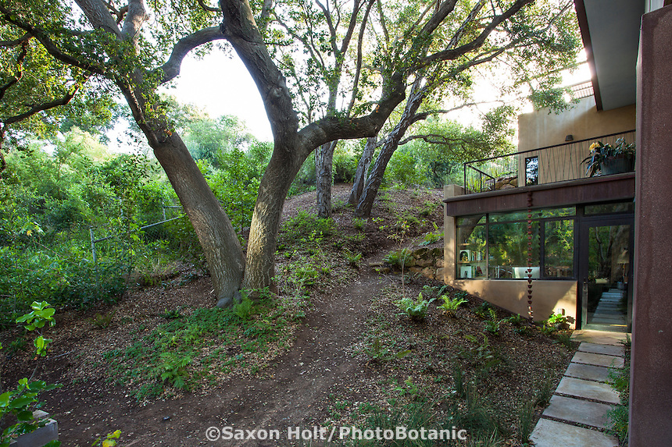
Tree Inspections for Real Estate Transactions
James Komen, Class One Arboriculture Inc.
BCMA#WE-9909B
RCA#555
818-495-5344
classonearboriculture@gmail.com

Slide 2
Purpose of Inspection
Tree Protection Ordinance Compliance
Tree Risk Assessment
Tree Appraisal
Anticipate the effects of change over time

Slide 3
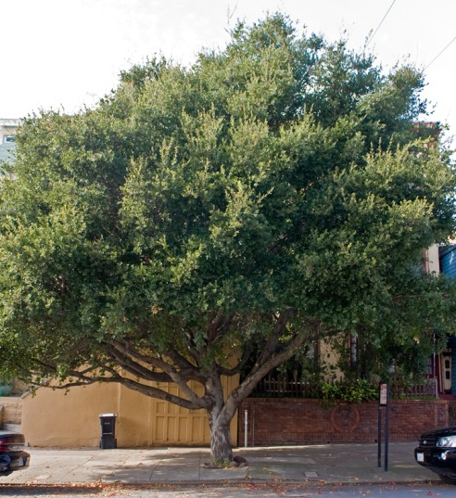
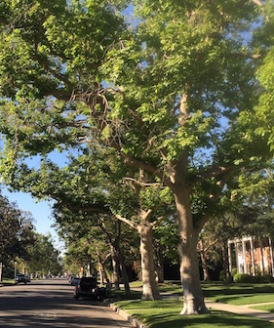
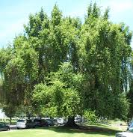
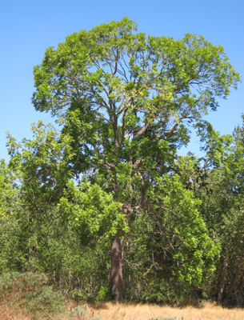
Tree Protection Ordinance Compliance
Locally Protected Species
  City of Los Angeles: Oak, Sycamore, Bay Laurel, Walnut

Slide 4
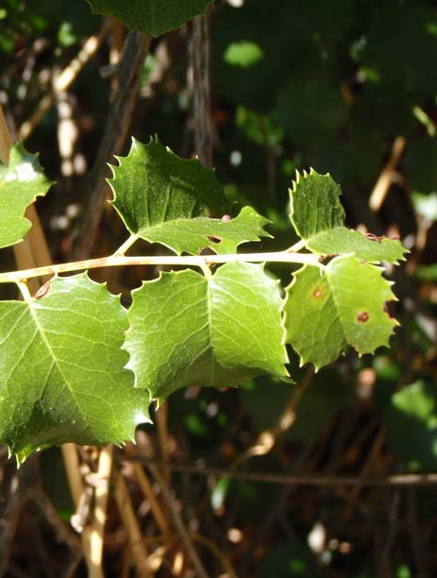
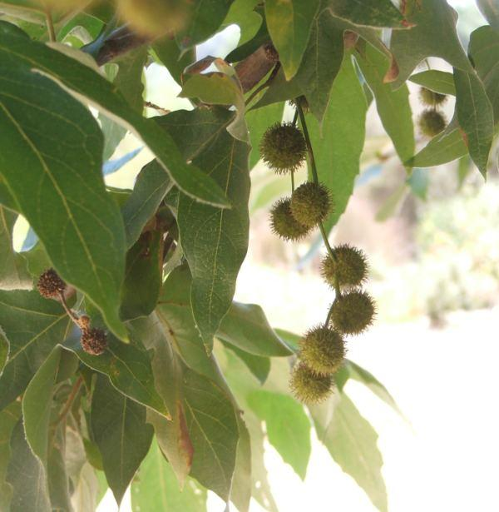
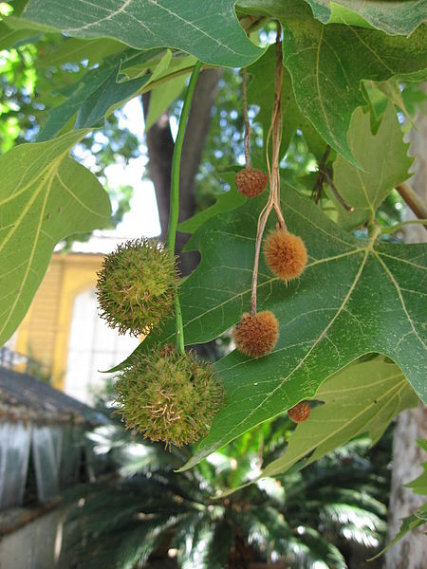
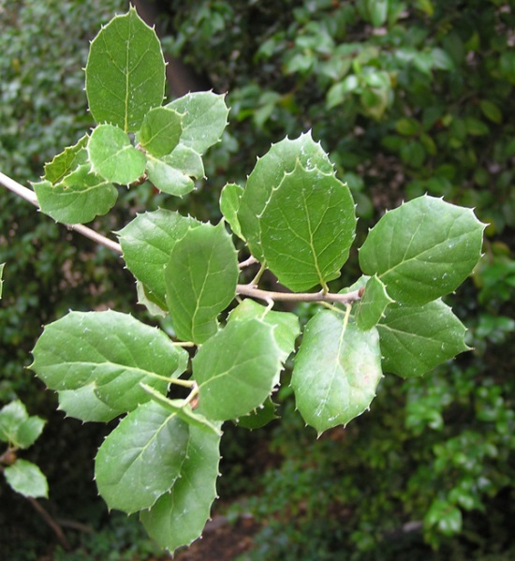
Tree Protection Ordinance Compliance

Slide 5
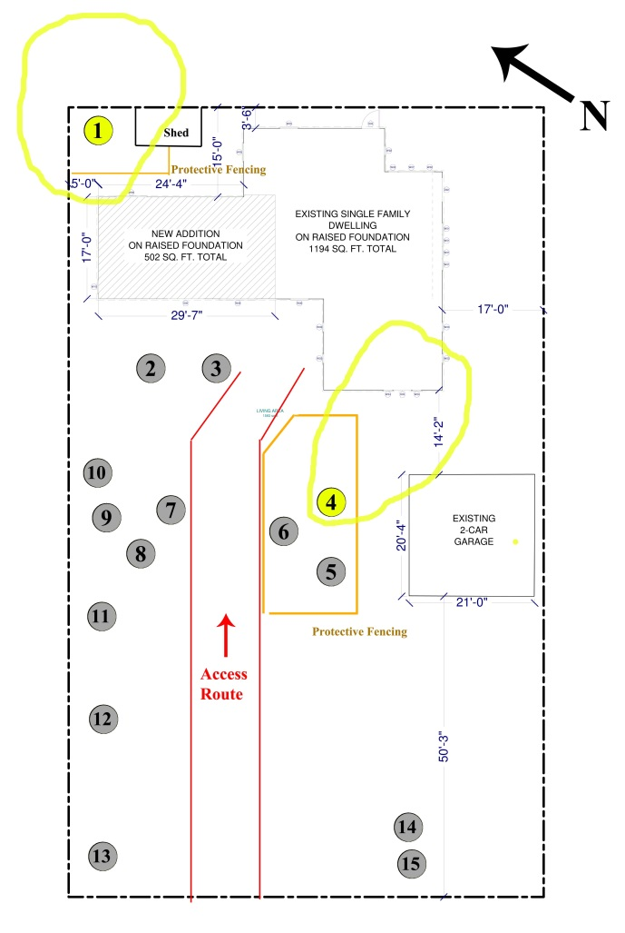
Tree Protection Ordinance Compliance
Anticipated construction, addition, or remodeling

Slide 6
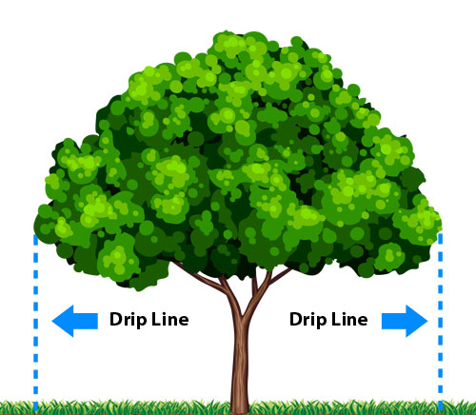
Tree Protection Ordinance Compliance
Construction near drip line
Extent of root system
Potential impact on roots
Mitigation measures
  Post and grade beam
  Industrial foam padding
  Air spade

Slide 7
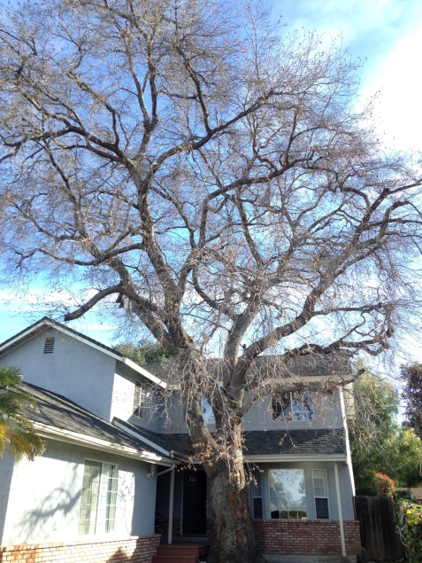
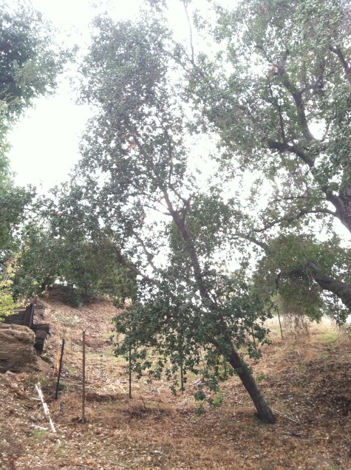
Tree Protection Ordinance Compliance
Tree Removals
  Dead, dying, hazardous
  Inhibit the reasonable use of the real property

Slide 8
Tree Protection Ordinance Compliance
Review:
  Identify Protected Species
  Prepare Tree Protection Plan
  Removal Permit Application

Slide 9
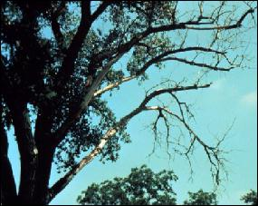
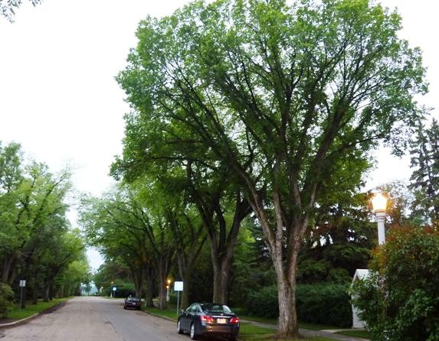
Tree Risk Assessment
Determine if hazardous conditions exist
Assess the risk exposure to the property owner

Slide 10
Tree Risk Assessment
Risk/Benefit Tradeoff
  All Trees Pose Risk
  Trees Provide Benefits
  Benefits usually outweigh the risk
“The Only Way to Eliminate All Risk is to Eliminate All Trees.”

Slide 11
Components of Risk Assessment
Likelihood of Failure
  Ratings
    Improbable
    Possible
    Probable
    Imminent
  Factors
    Site conditions
    Tree defects
      Tree-specific
      Species-specific
    Time Period

Slide 12
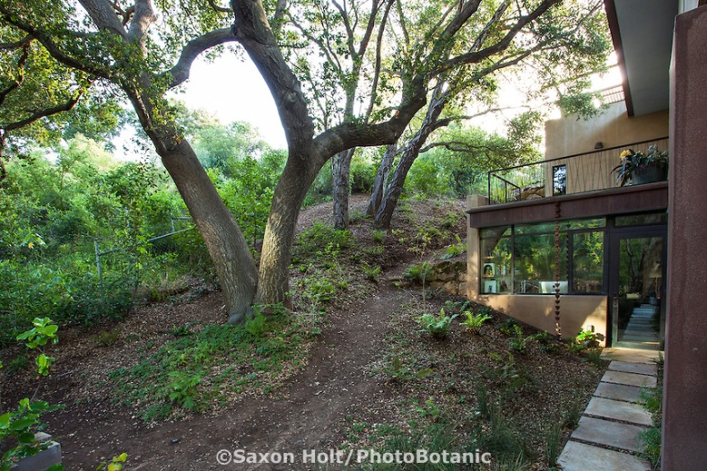
Components of Risk Assessment
Likelihood of Impact
  Ratings
    Very Low
    Low
    Medium (50/50)
    High
  Factors
    Occupancy Rate
    Direction of Fall

Slide 13
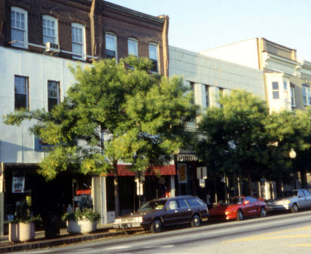
Components of Risk Assessment
Consequences of Failure
  Ratings
    Negligible
    Minor
    Significant
    Severe
  Factors
    Distance of Fall
    Weight of Tree Part
    Value of Target

Slide 14
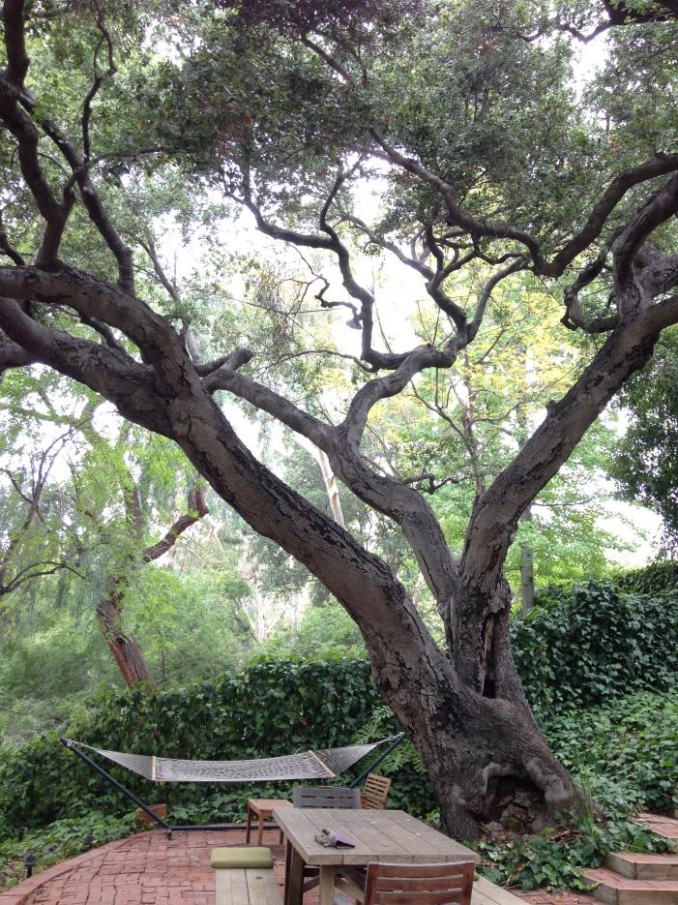
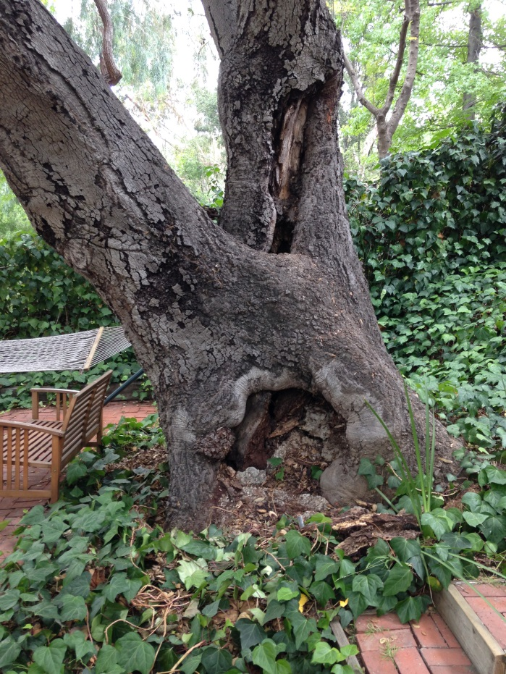
Tree Risk Assessment

Slide 15
Tree Risk Assessment
Review
  Three components of risk assessment
  Why prepare a tree risk assessment?
  Possible to eliminate all risk?

Slide 16
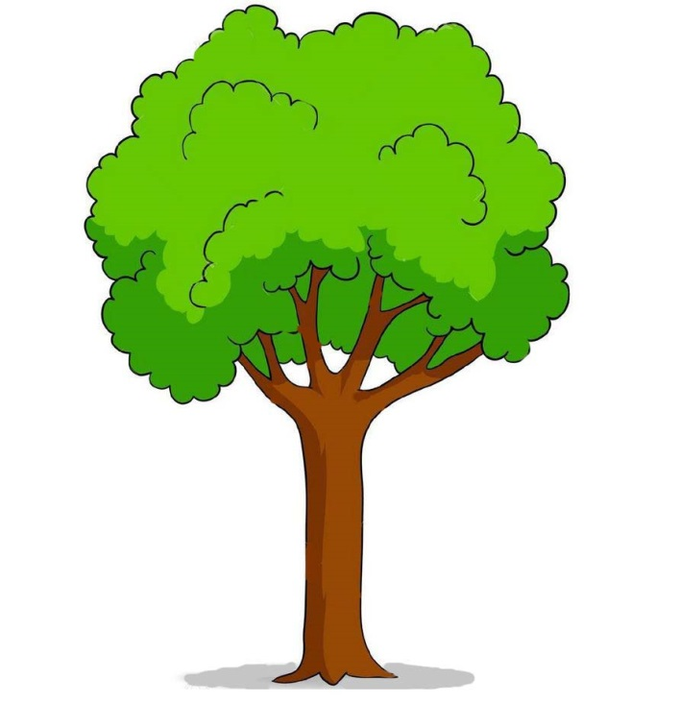

Tree Appraisal
Trees add monetary value to a property
A well-maintained landscape can contribute 10% or more of a property’s value
Different approaches to Appraisal:
  Cost approach
  Income approach
  Market approach

Slide 17
Tree Appraisal
Property marketing selling point
Dispute resolution if trees are damaged during or after escrow
Evaluate tradeoffs when making construction decisions

Slide 18
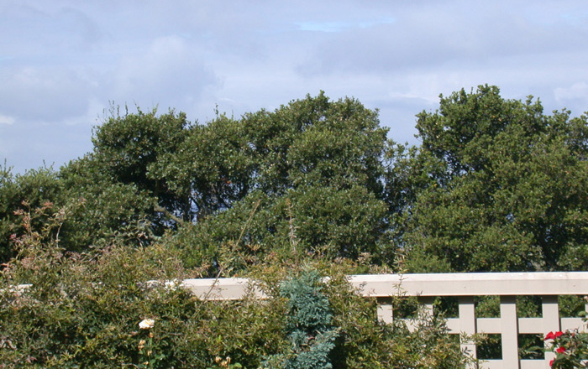
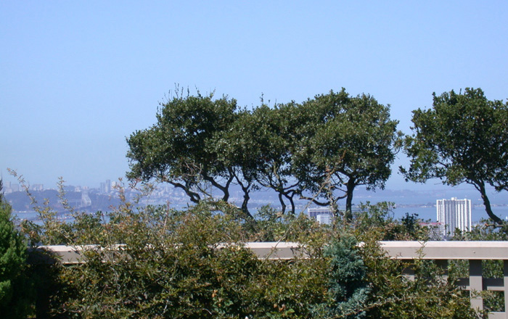
Trees and Views

Slide 19
Trees and Views
Anticipate tree growth rate and frequency of pruning
Potential conflict with neighbors
  Buyer of the View:
    Document the view at the time of purchase
    Obtain permission to perform work on trees
    Express your desire to preserve the view before it becomes a conflict
  Buyer of the Trees:
    Document the height and size of the trees
    Express your desire to preserve the trees before it becomes a conflict
  Put a private management agreement into WRITING

Slide 20
Trees and Views
Review
  Why involve an arborist from the beginning?
  What should be documented?
    View-buyer, concerned about neighbor’s trees
    Tree-buyer, concerned about neighbor’s view
  Why put a management agreement into writing?

Slide 21
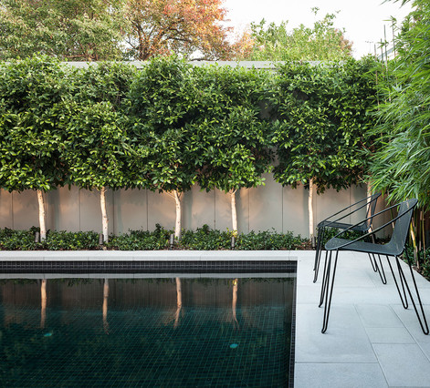
Tree Inspection Case Study
Ficus Trees by a Pool Deck

Slide 22
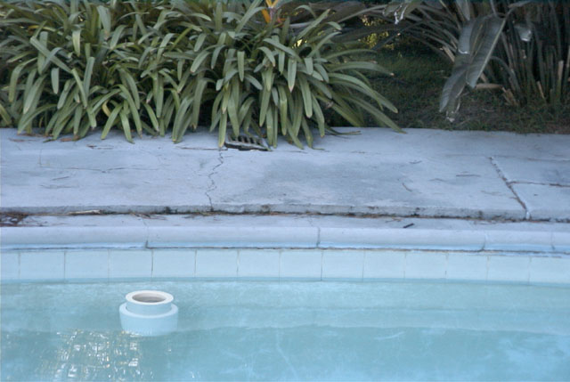
Tree Inspection Case Study
Ficus Trees by a Pool Deck

Slide 23
Tree Inspection Case Study
Ficus Trees by a Pool Deck
  Anticipate root damage timeline
  Take appropriate mitigation measures
    Install root barrier
    Prune the trees to a topiary form
    Remove and replace the trees

Slide 24
Types of Tree Professionals
Certified Tree Worker
Certified Arborist
Qualified Tree Risk Assessor (TRAQ)
Board Certified Master Arborist (BCMA)
Registered Consulting Arborist (RCA)

Slide 25
Where to Find an Arborist
International Society of Arboriculture (ISA):
www.isa-arbor.com
American Society of Consulting Arborists (ASCA):
www.asca-consultants.org
City Referral Directory
Yelp or Angie’s List
  Make sure to verify credential with ISA or ASCA

Slide 26
Types of Tree Professionals
Review:
  Who to hire for pruning?
  Who to hire for supervising pruning?
  Who to hire for Tree Risk Assessment?
  Who to hire for consulting?

Slide 27
Tree Inspections for Real Estate Transactions
James Komen, Class One Arboriculture Inc.
BCMA#WE-9909B
RCA#555
818-495-5344
classonearboriculture@gmail.com

