Slide 1


White Hat Hacking
the
TRAQ Methodology
James Komen
BCMA #WE-9909B
RCA #555
Columbus, OH
August 7, 2018

Slide 2

Hacking
Black Hat
White Hat
Exploits system weaknesses for personal gain
Locates system weaknesses to inform users and improve the system

Slide 3
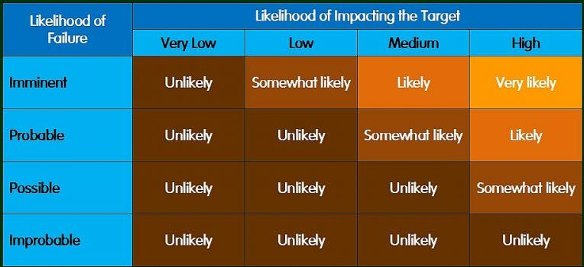
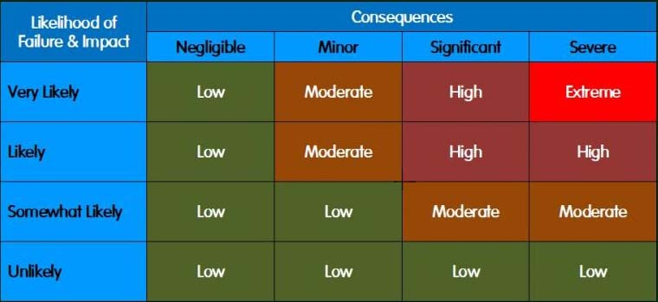
TRAQ Methodology
Components
  Likelihood of failure
  Likelihood of impact
  Consequences of failure
Terms
  Time Frame
  Risk Categorization
  Risk Rating
  Overall Risk Rating

Slide 4
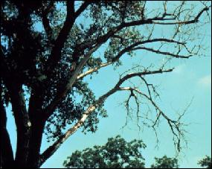
Likelihood of Failure
Chance that the tree or tree part will fail in a given time frame
  Imminent
  Probable
  Possible
  Improbable

Slide 5
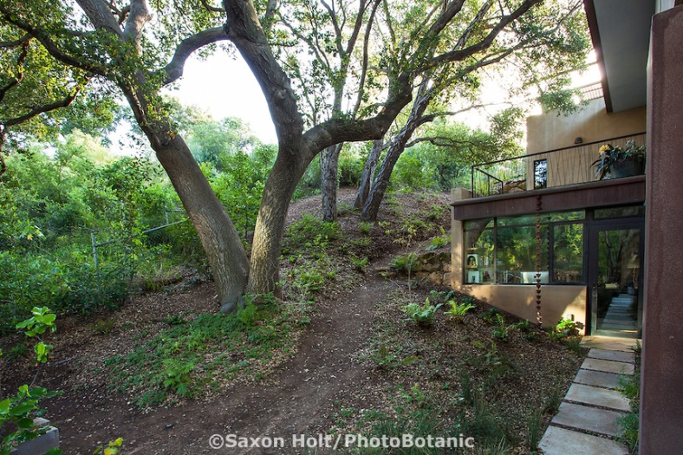
Likelihood of Impact
Chance that the tree or tree part will strike the target if it were to fail
  High
  Medium
  Low
  Very Low

Slide 6
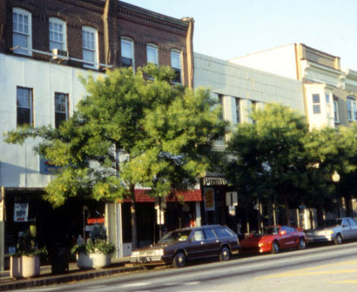
Consequences of Failure
The amount of damage or harm caused by a tree or tree part failing and impacting a target.
  Severe
  Significant
  Minor
  Negligible

Slide 7

Time Frame
The period of time over which the likelihood of failure is assessed.

Slide 8
Risk Rating
Combination of three components:
  Likelihood of Failure
  Likelihood of Impact
  Consequences of Failure

Slide 9
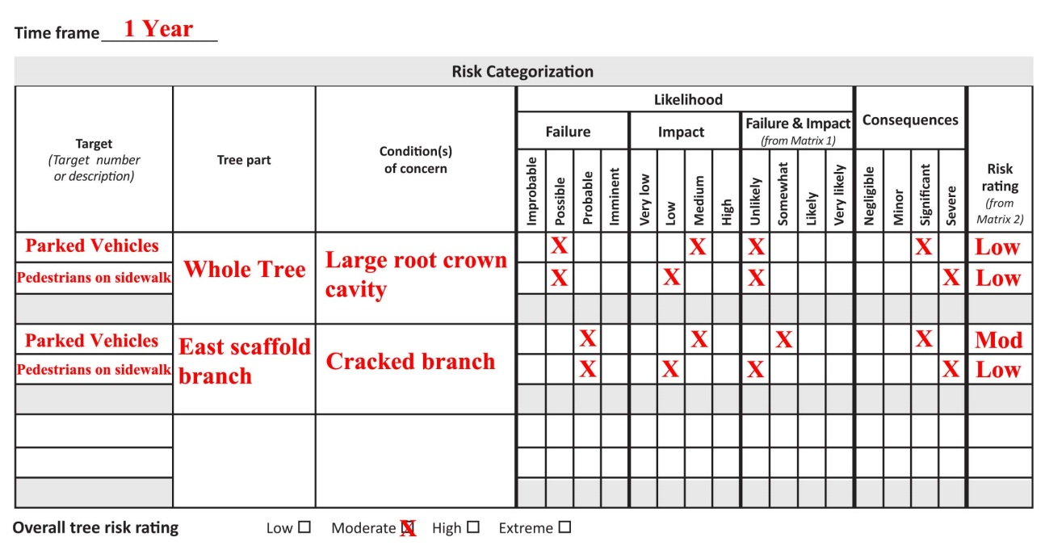
Risk Categorization
Combining components of risk assessment

Slide 10
Overall Risk Rating
Highest Risk Rating combination

Slide 11
Overall Risk Rating
Highest Risk Rating combination

Slide 12
Black Hat Hacking TRAQ
Splitting Targets
Splitting Tree Parts
Modifying Time Frame

Slide 13
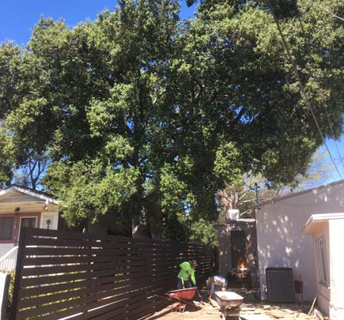
Splitting Targets
Quercus agrifolia
  Between two houses
  Known basal cavity defect in trunk
  Direction of fall is not known

Slide 14
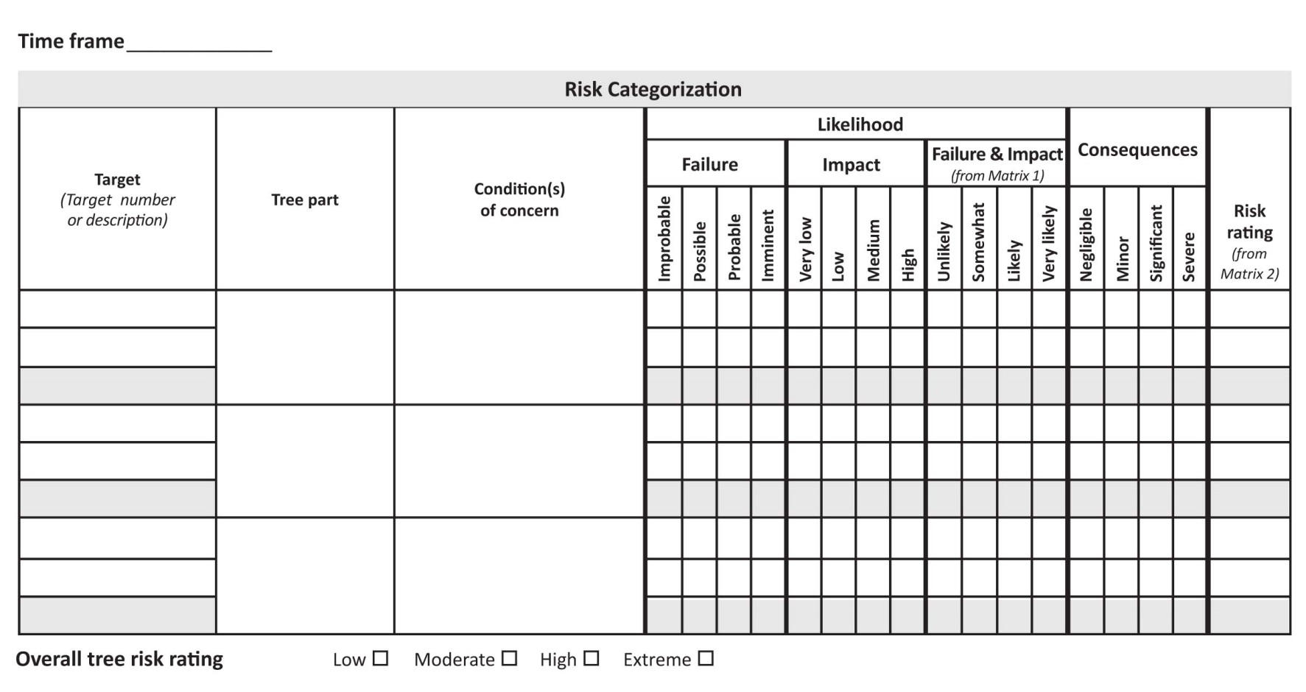
Splitting Targets

Slide 15
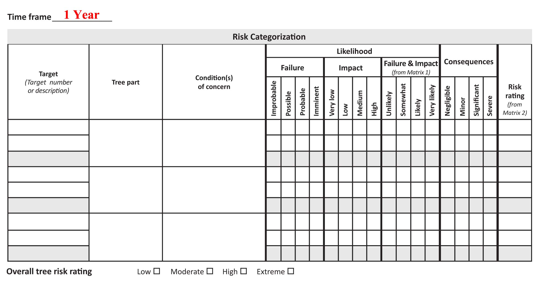
Splitting Targets

Slide 16
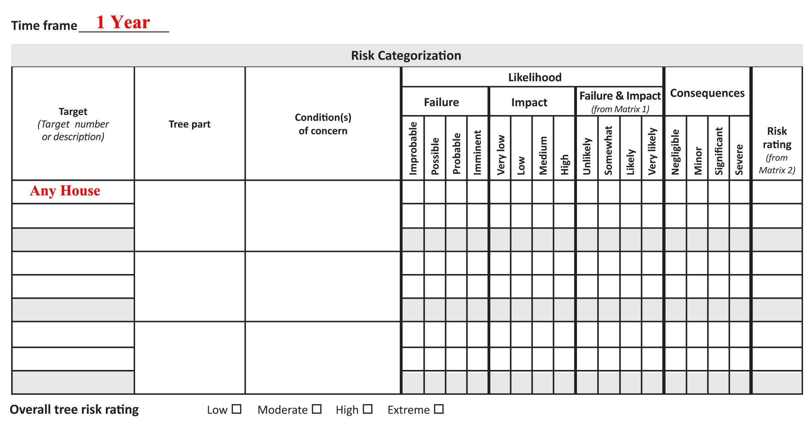
Splitting Targets

Slide 17
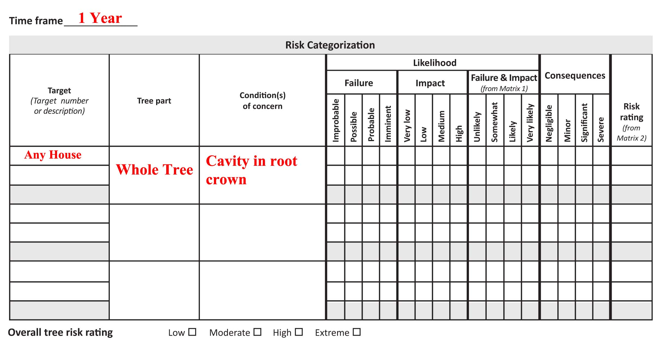
Splitting Targets

Slide 18
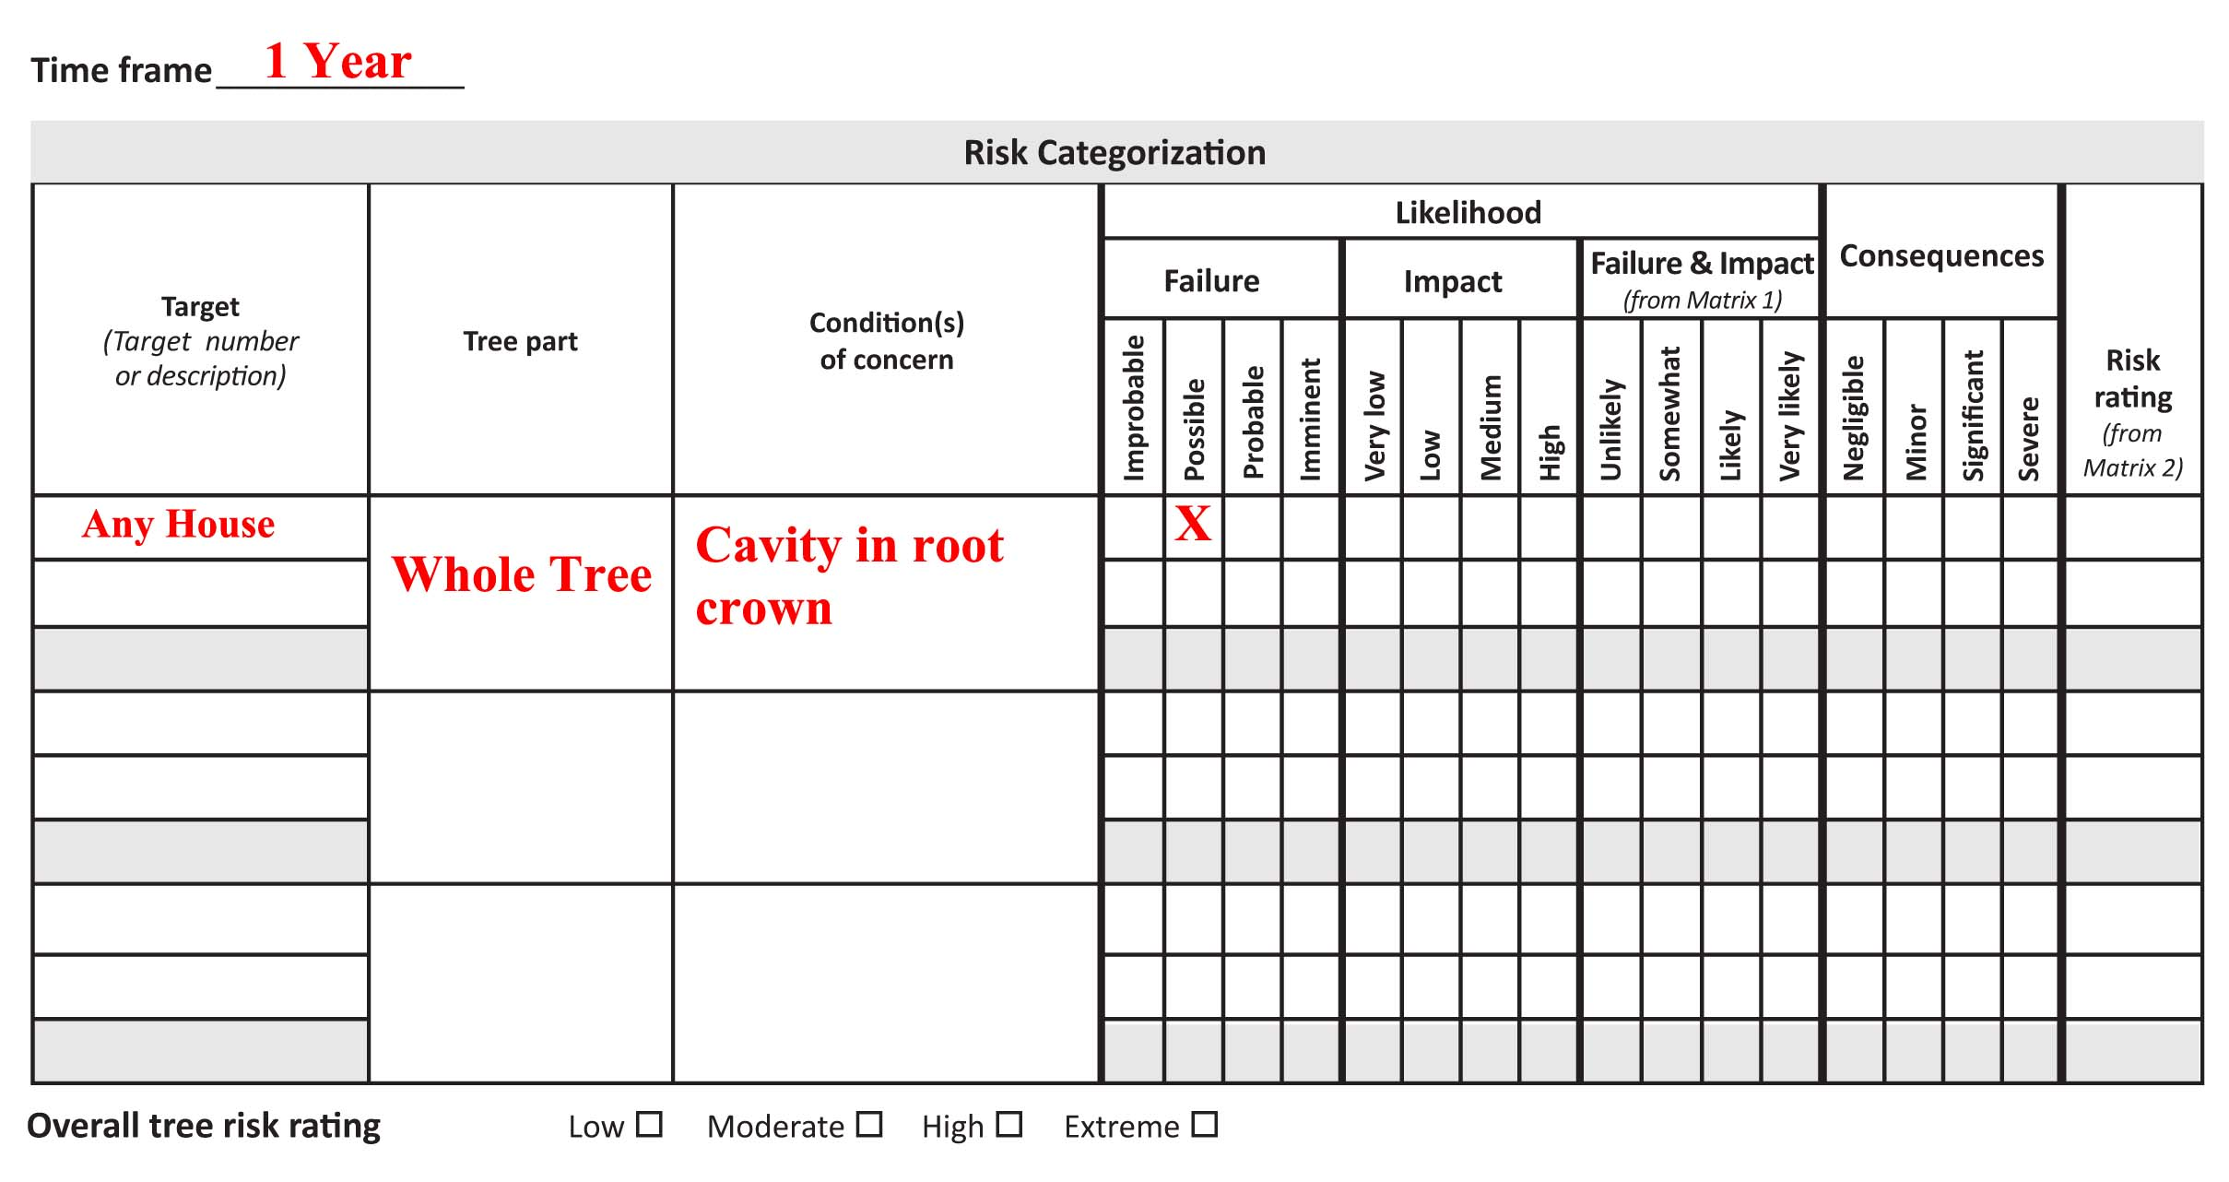
Splitting Targets

Slide 19
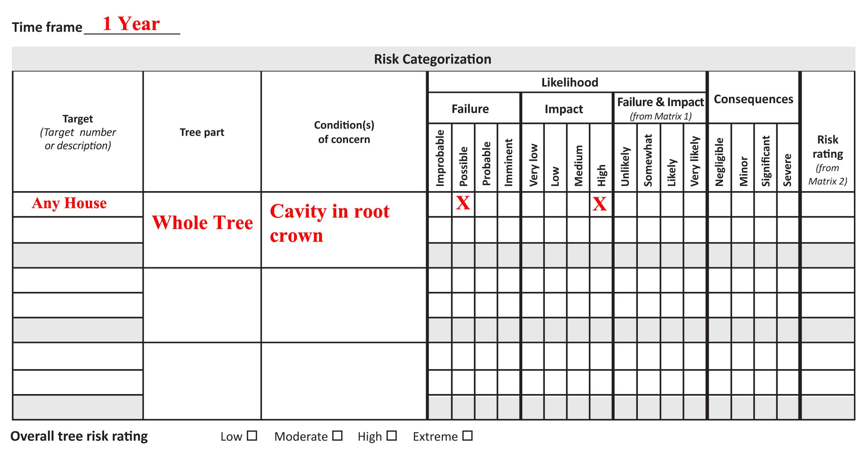
Splitting Targets

Slide 20
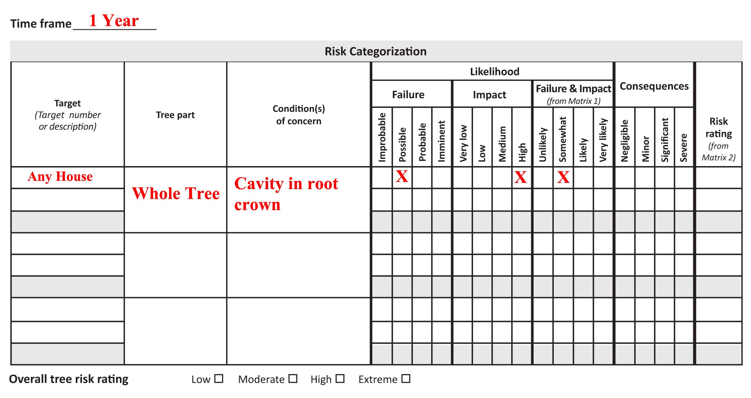
Splitting Targets

Slide 21
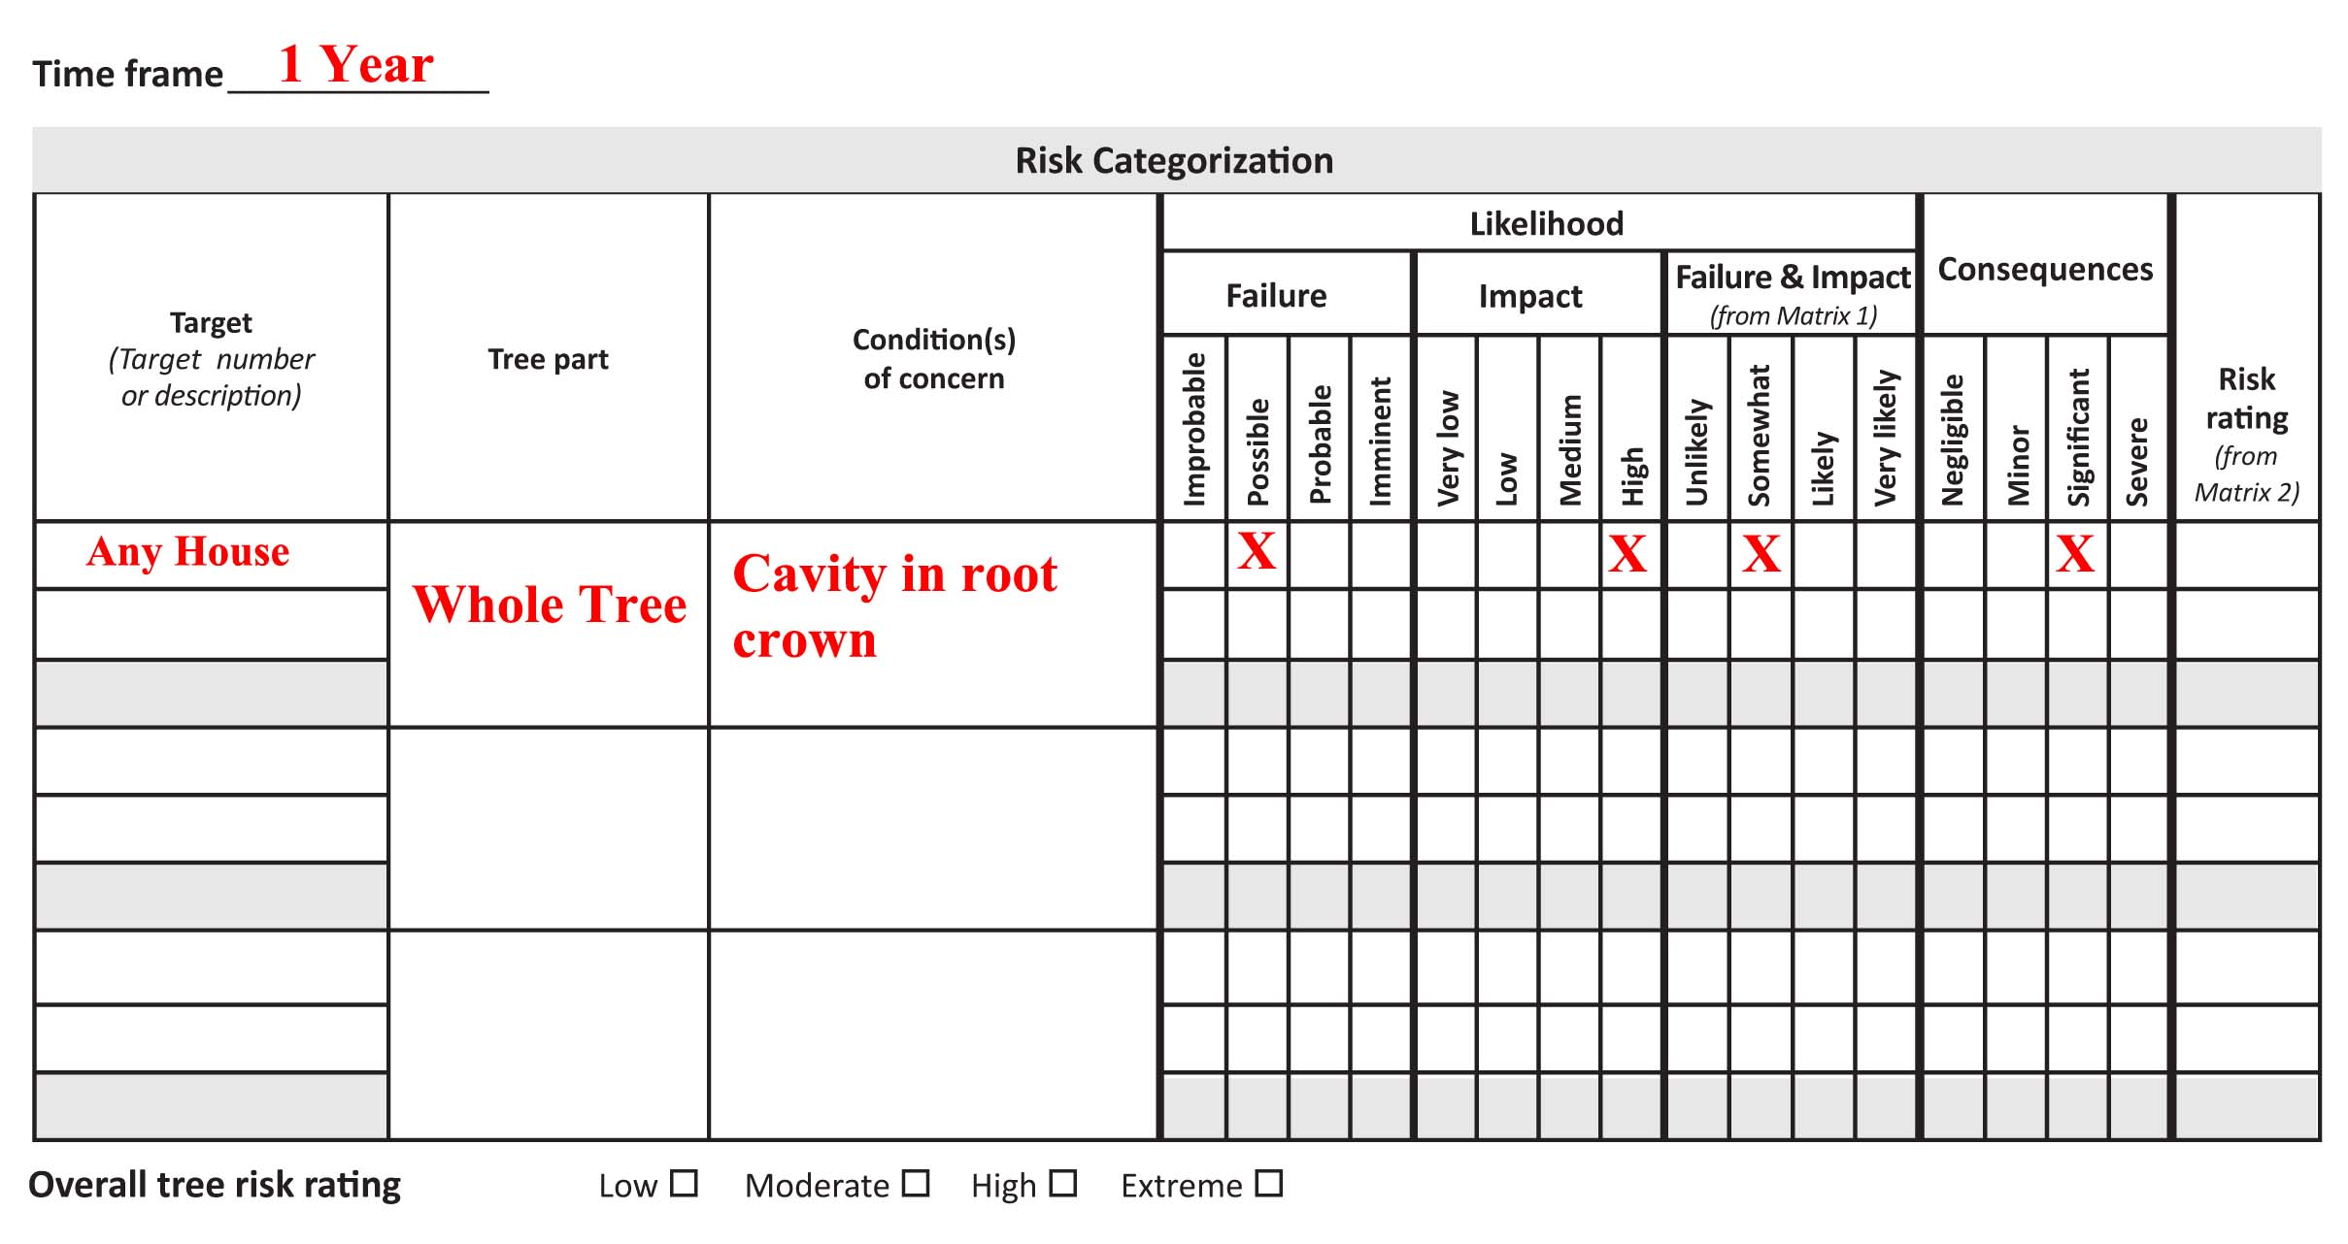
Splitting Targets

Slide 22
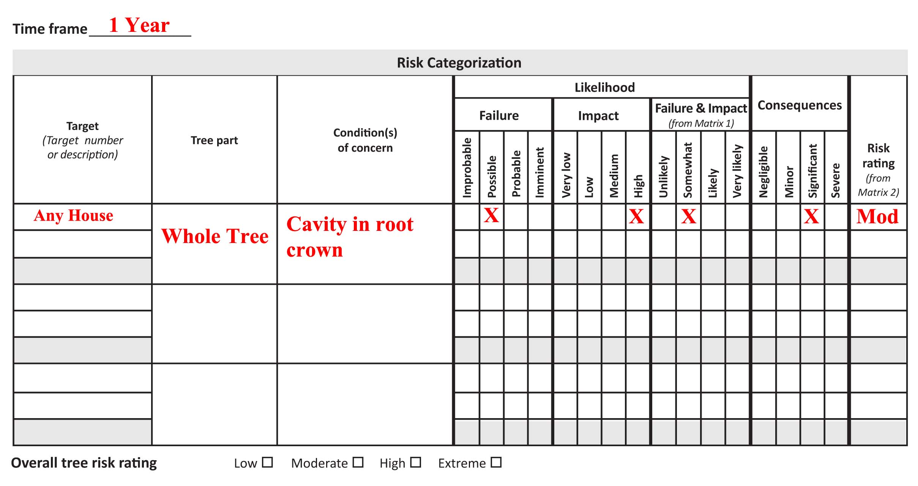
Splitting Targets

Slide 23
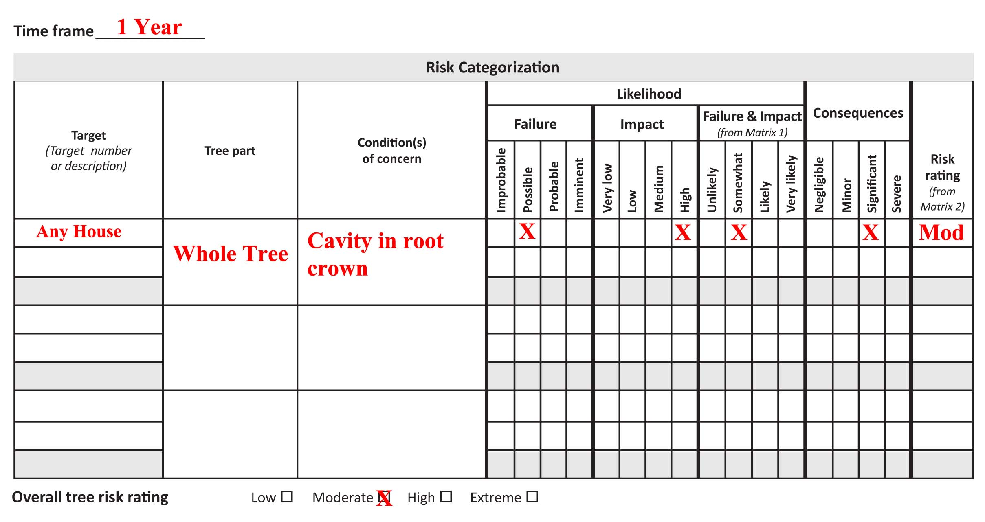
Splitting Targets

Slide 24
Splitting Targets
High likelihood of impact
Medium likelihood of impact
Tree or tree part may be EXPECTED to impact the target if it were to fail.
Tree or tree part COULD impact the target if it were to fail but impact is not expected.

Slide 25
Splitting Targets
Quercus agrifolia
  Between two houses
  Known basal cavity defect in trunk
  Direction of fall is not known

Slide 26
Splitting Targets

Slide 27
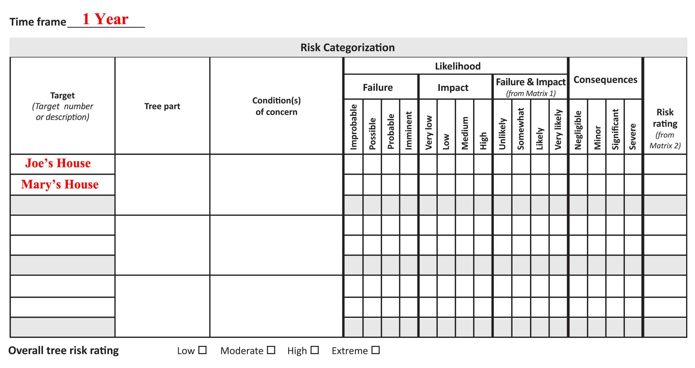
Splitting Targets

Slide 28
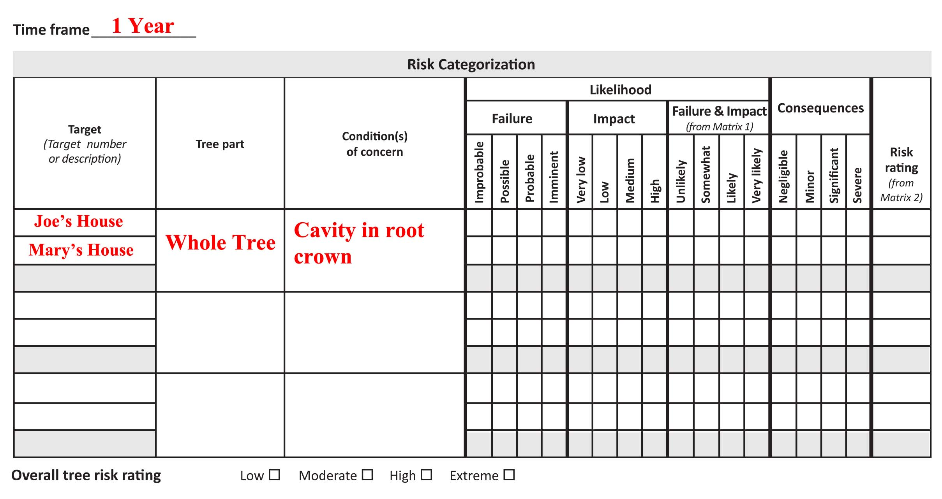
Splitting Targets

Slide 29
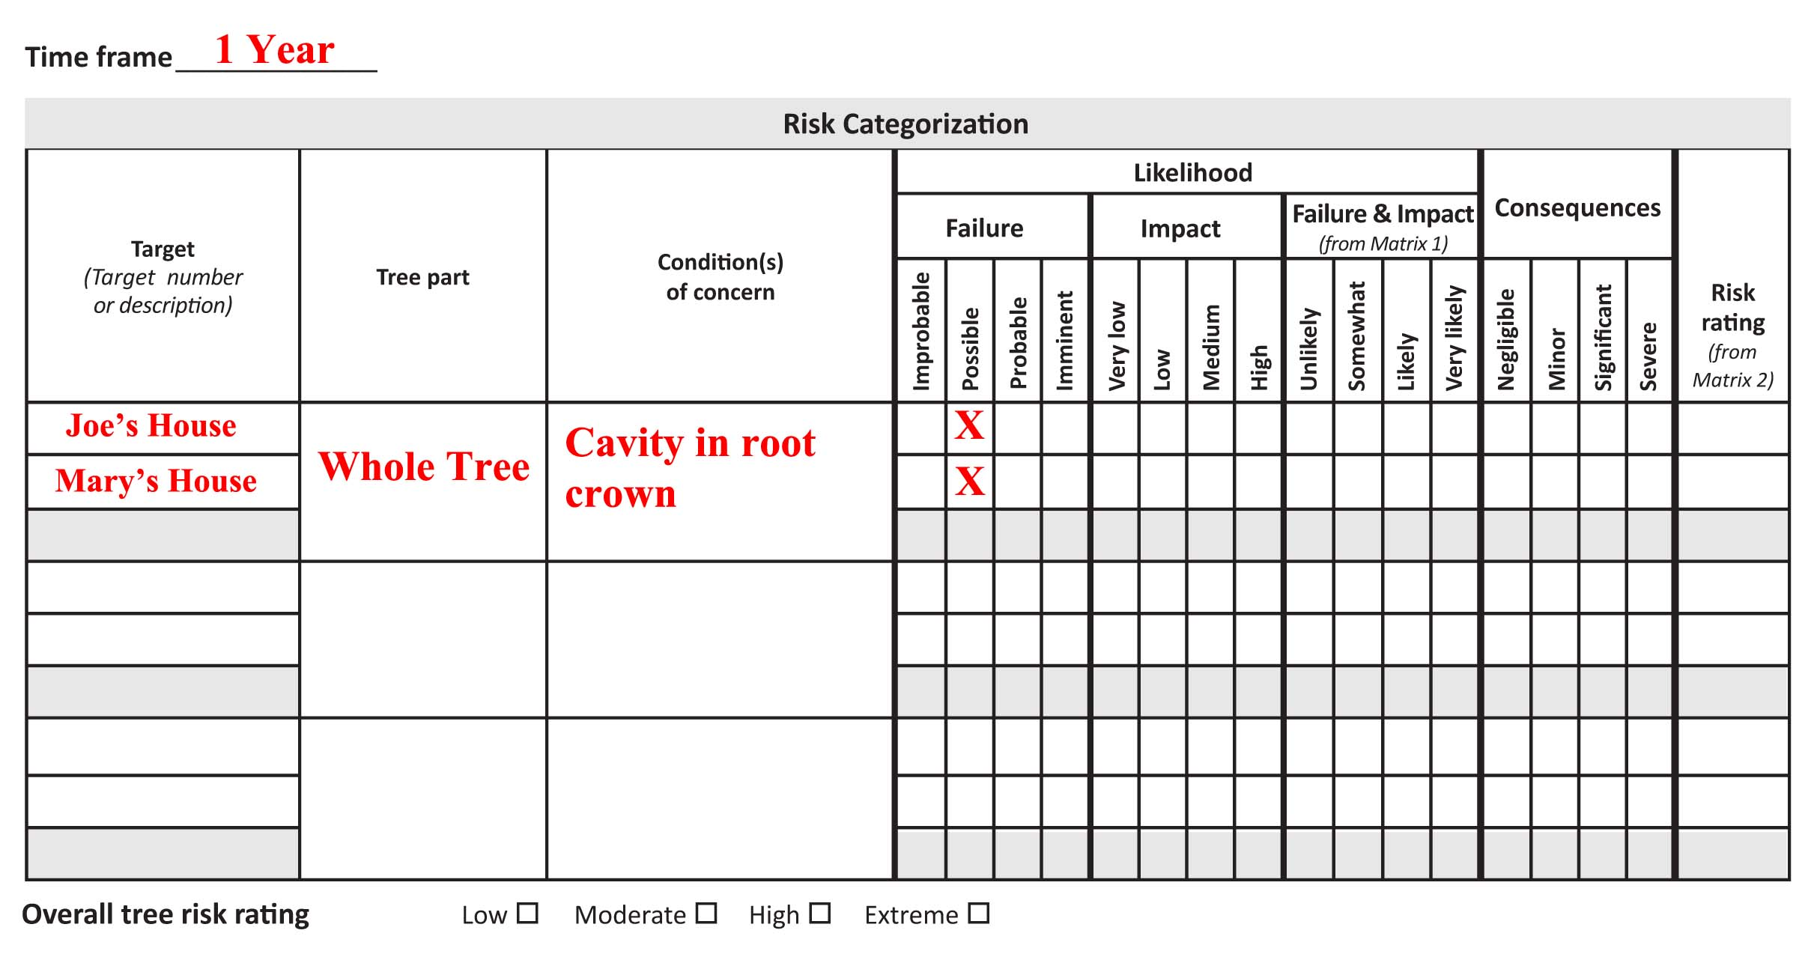
Splitting Targets

Slide 30
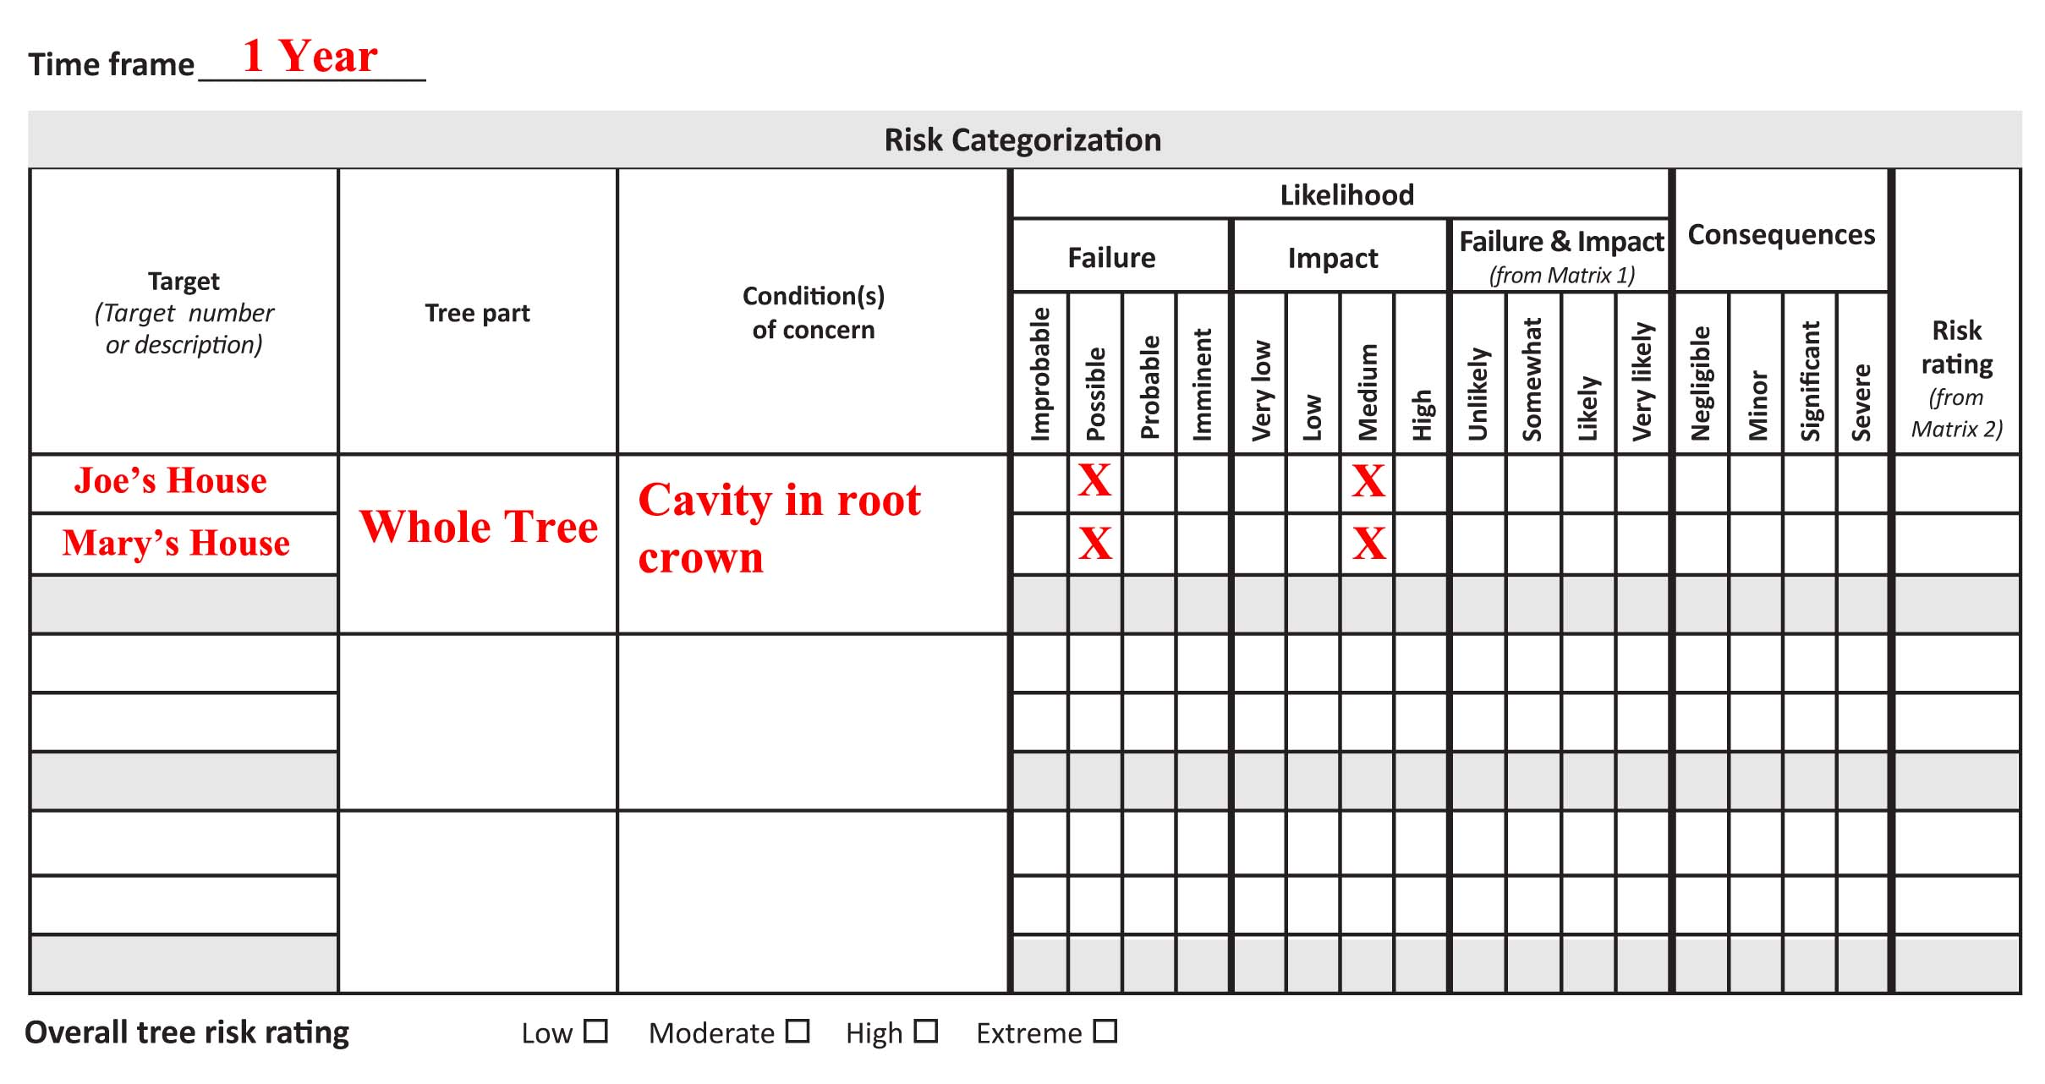
Splitting Targets

Slide 31

Splitting Targets

Slide 32
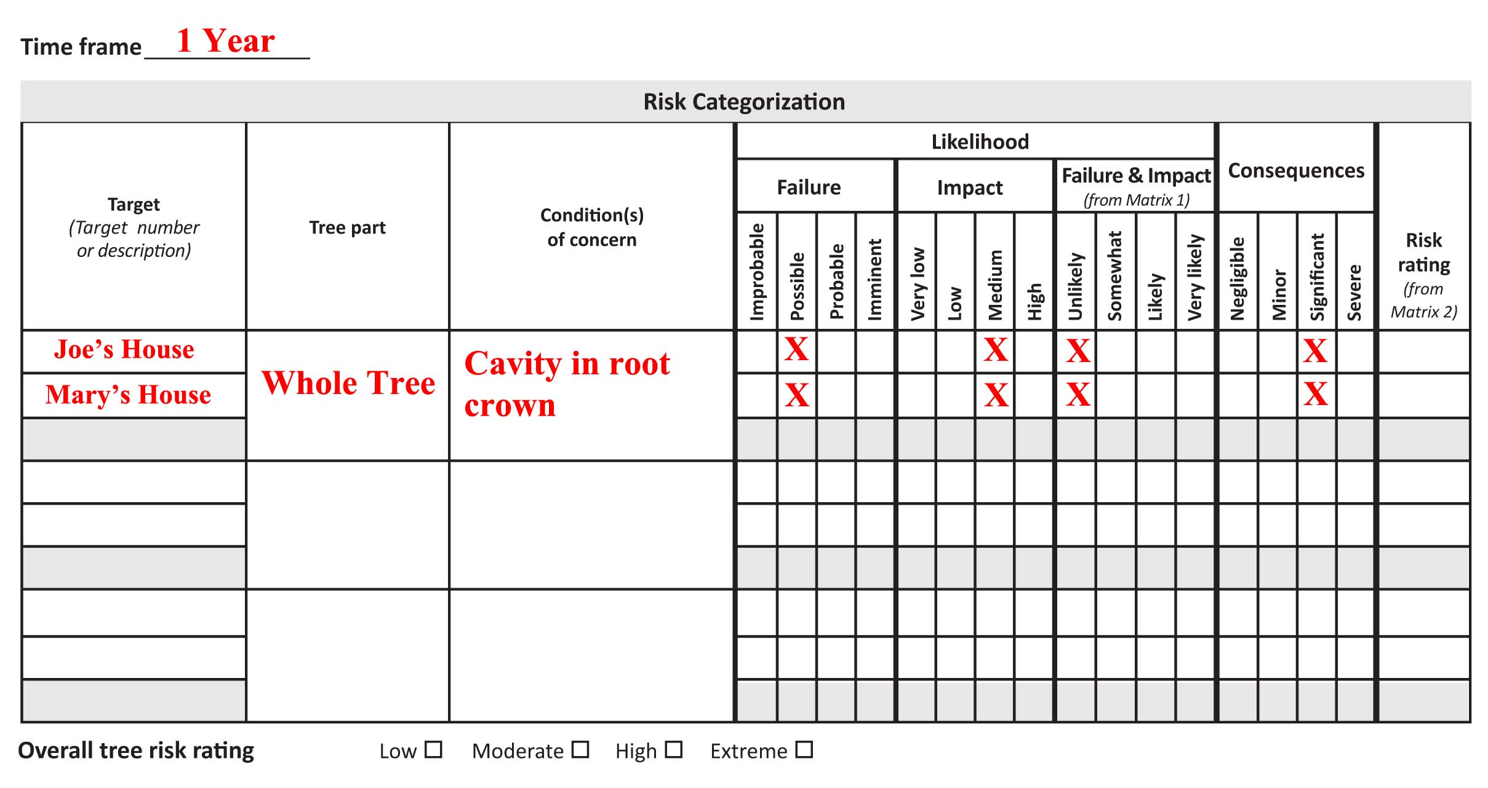
Splitting Targets

Slide 33
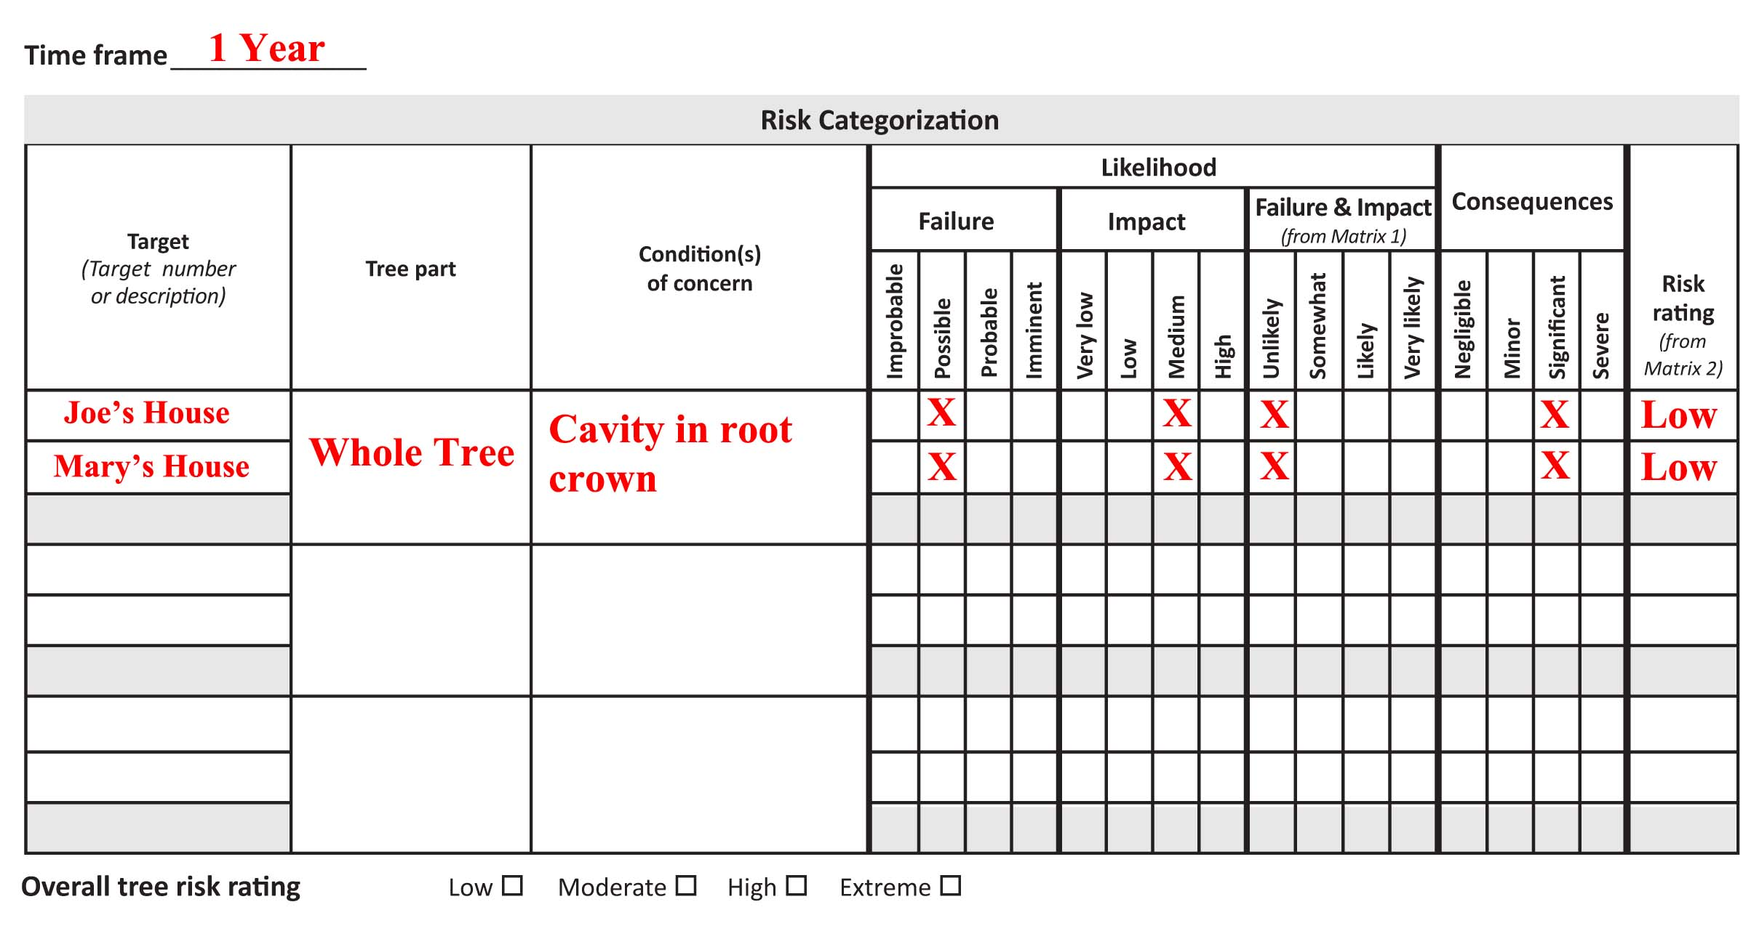
Splitting Targets

Slide 34
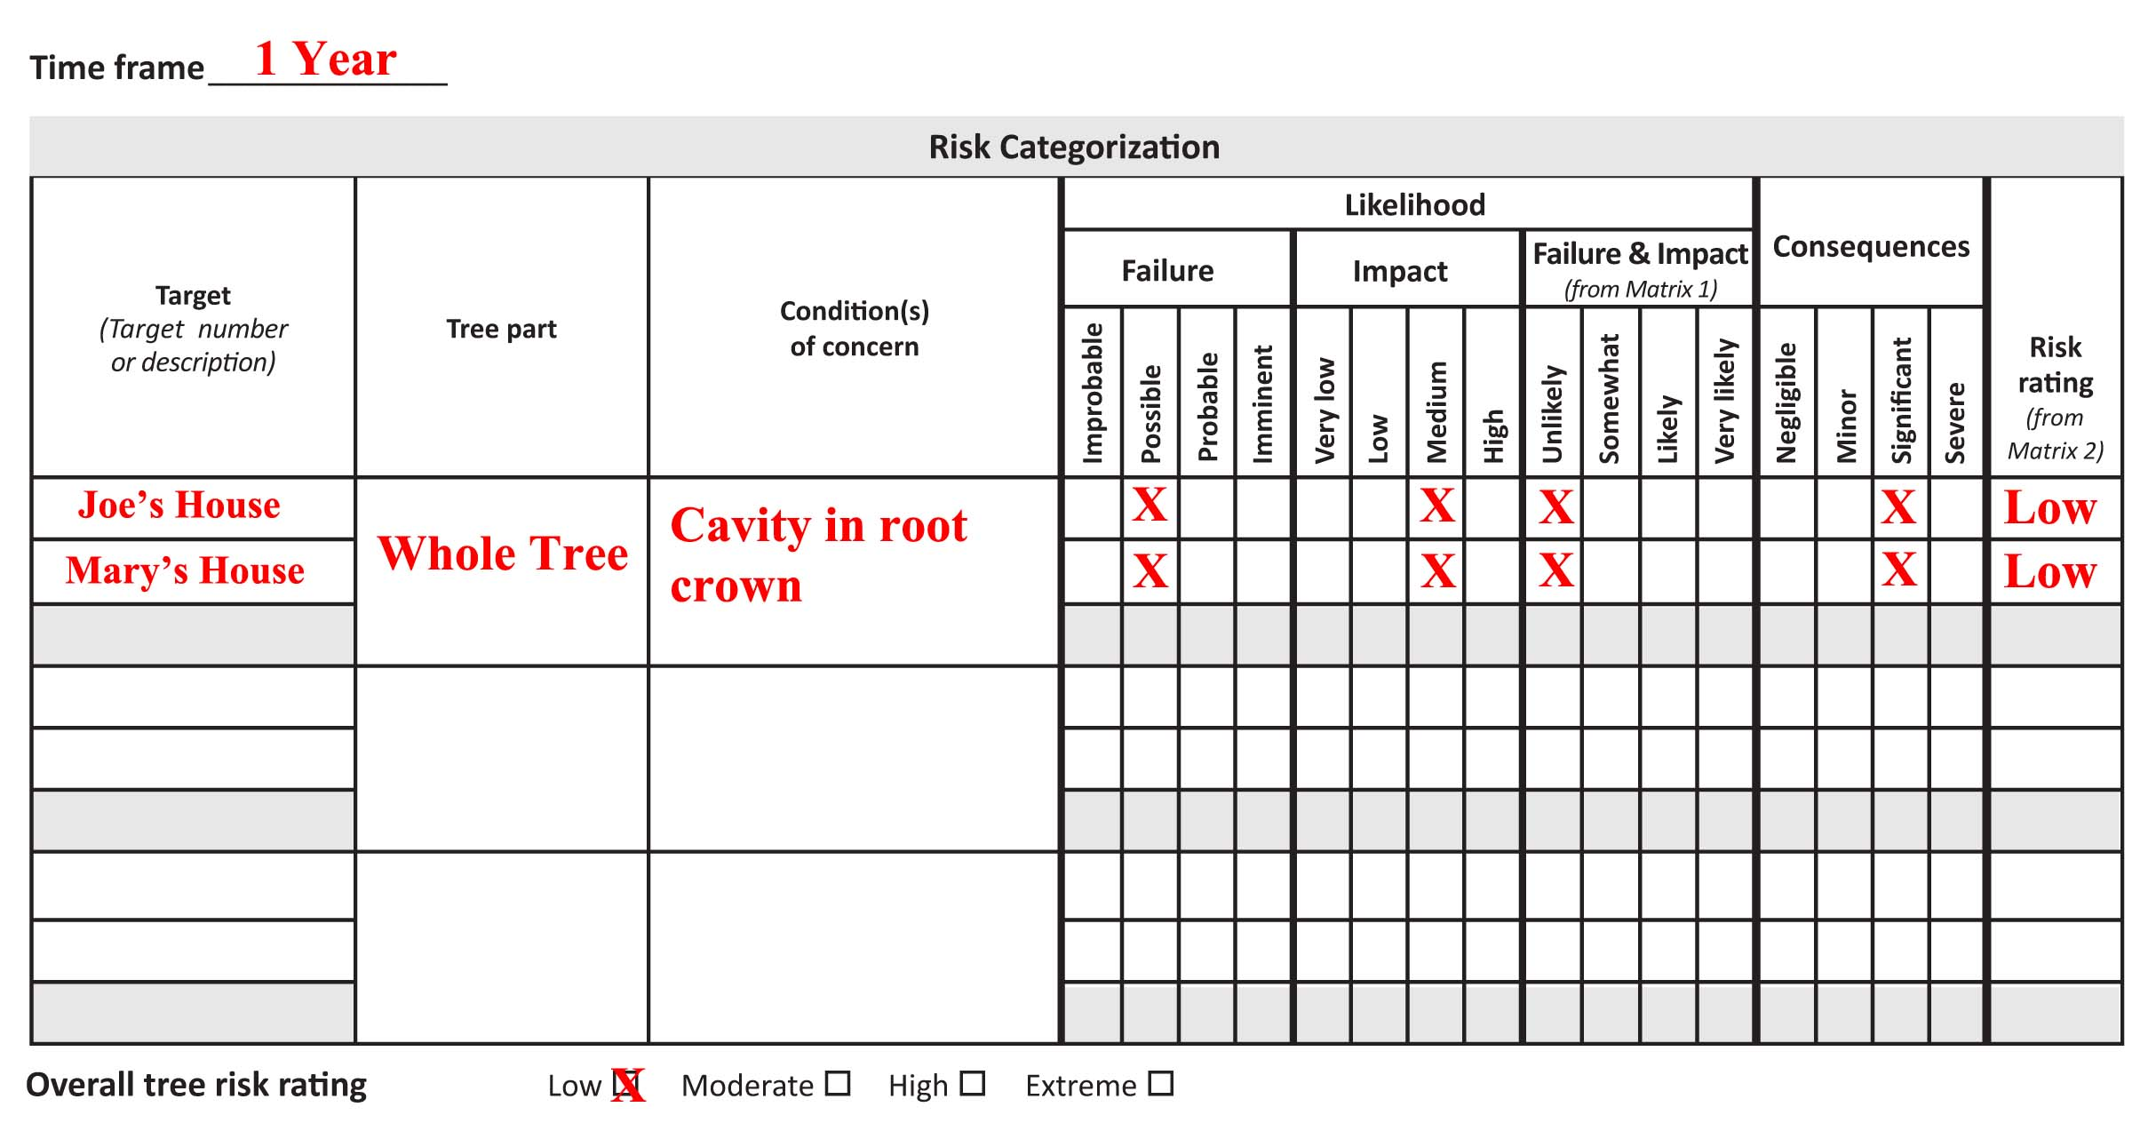
Splitting Targets

Slide 35
Splitting Targets
ANY House
  Overall Tree Risk: MODERATE
Joe’s House and Mary’s House
  Overall Tree Risk: LOW

Slide 36
Splitting Targets
Correlation Coefficient
  A measurement of the co-dependence of two variables
  Positive or Negative
  Not addressed in TRAQ methodology

Slide 37
Splitting Targets
Correlation Coefficient
  Negative Correlation
  If tree does NOT fall towards JOE’S HOUSE, then it will fall towards MARY’S HOUSE

Slide 38
Splitting Targets
Correlation Coefficient
  Likelihood of impacting A is MEDIUM
  Likelihood of impacting B is MEDIUM
  Likelihood of impacting either A or B is HIGH

Slide 39
Splitting Targets
Correlation Coefficient
  Likelihood of impacting ANY house is greater than the likelihood of impacting ONE SPECIFIC house.

Slide 40
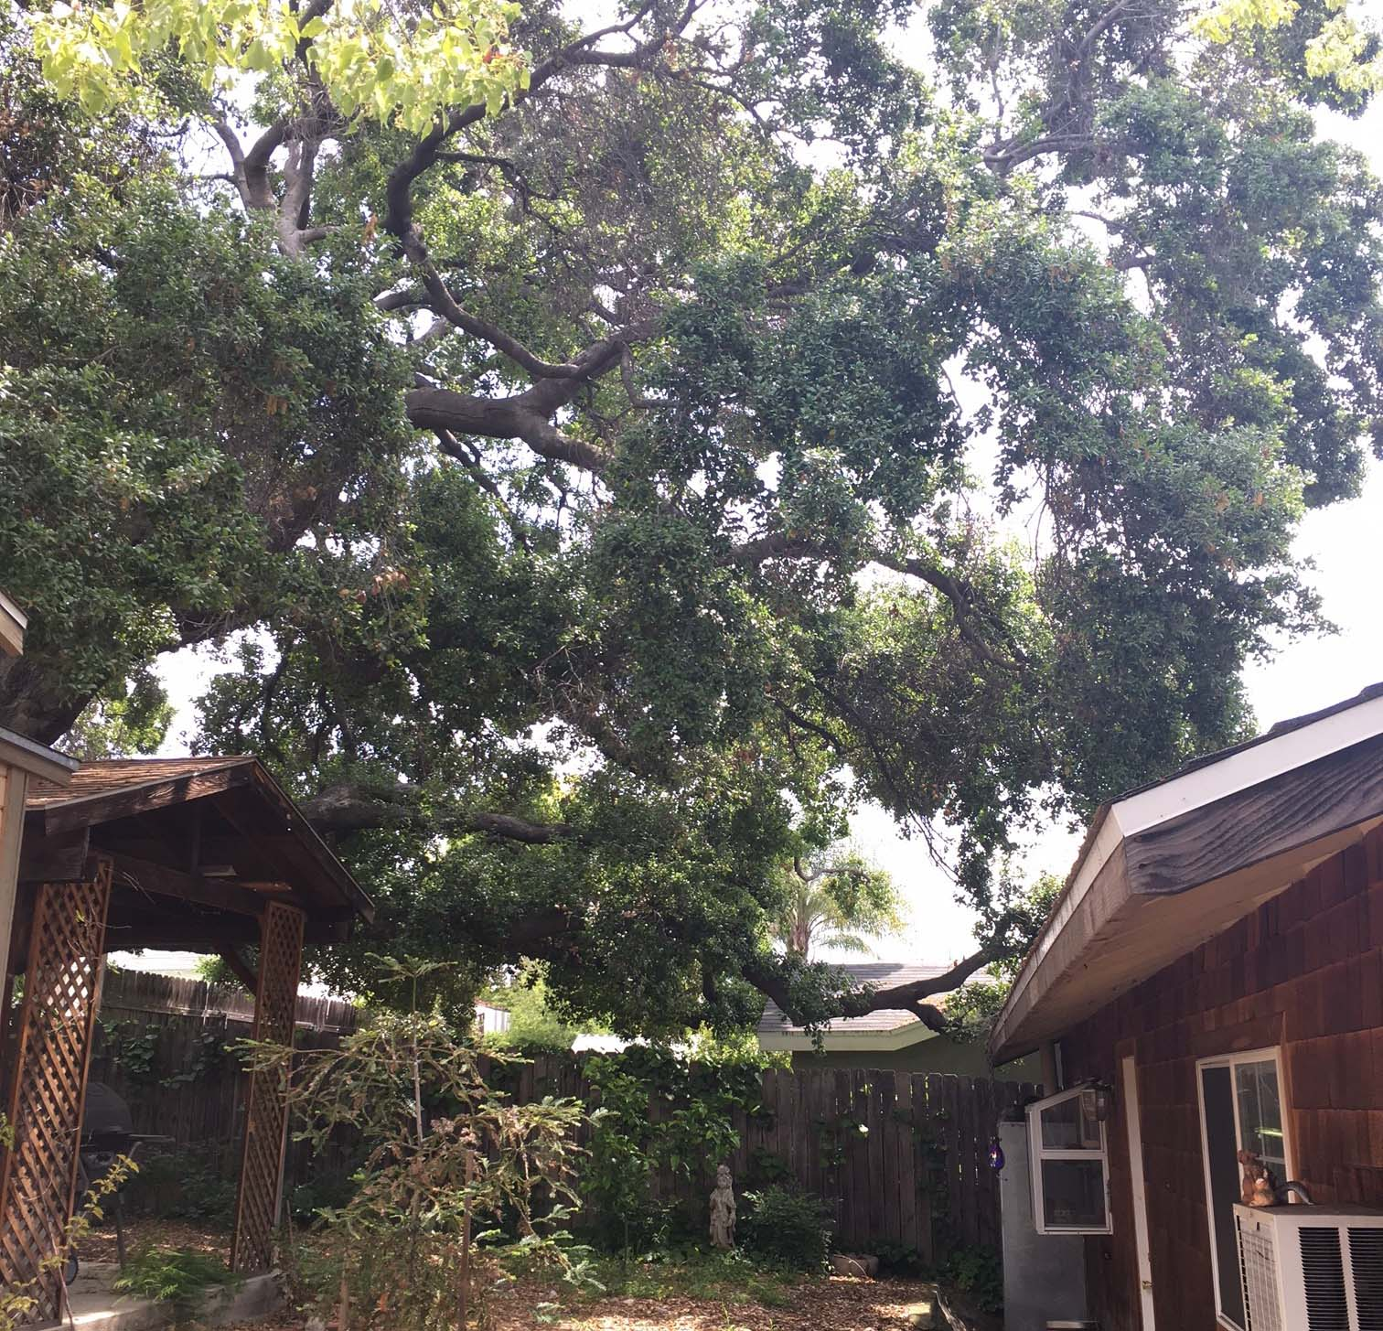
Splitting Tree Parts
Quercus agrifolia
  Several large scaffold branches overextended over house

Slide 41
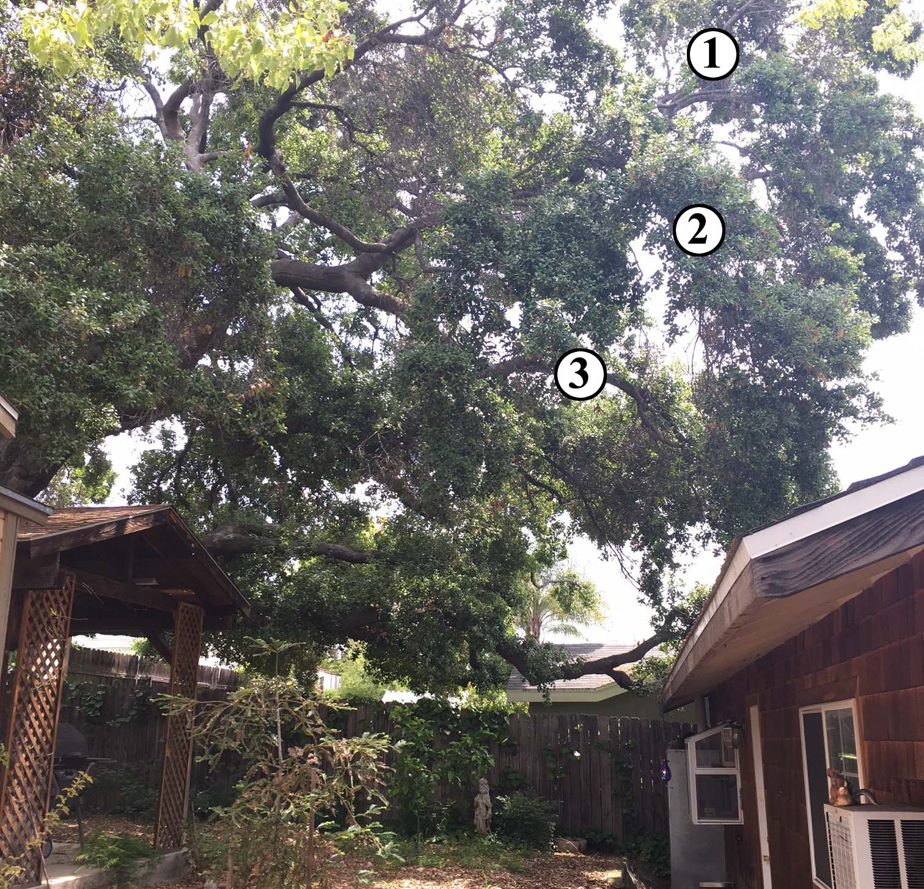
Splitting Tree Parts
Quercus agrifolia
  Several large scaffold branches overextended over house

Slide 42
Splitting Tree Parts
Quercus agrifolia
  Several large scaffold branches overextended over house
  If failure were to occur, likelihood of impact would be HIGH

Slide 43
Splitting Tree Parts
Quercus agrifolia
  Several large scaffold branches overextended over house
  If failure were to occur, likelihood of impact would be HIGH
  If impact were to occur, consequences would be SIGNIFICANT

Slide 44
Splitting Tree Parts

Slide 45

Splitting Tree Parts

Slide 46
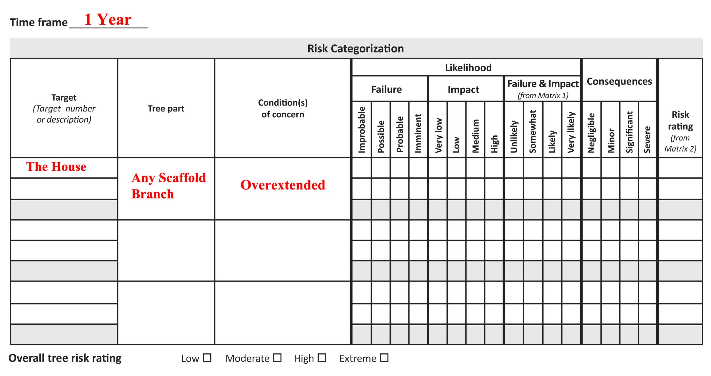
Splitting Tree Parts

Slide 47
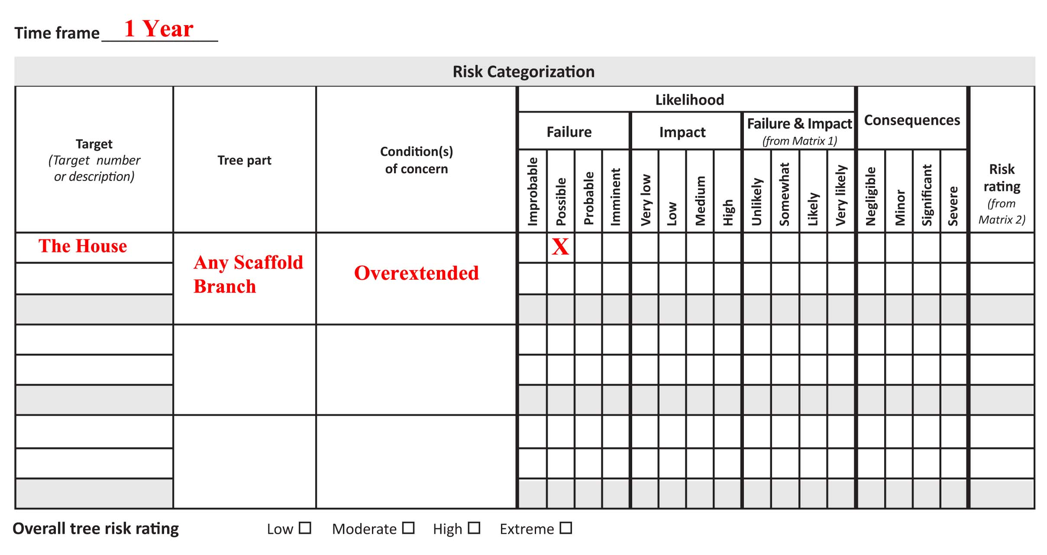
Splitting Tree Parts

Slide 48
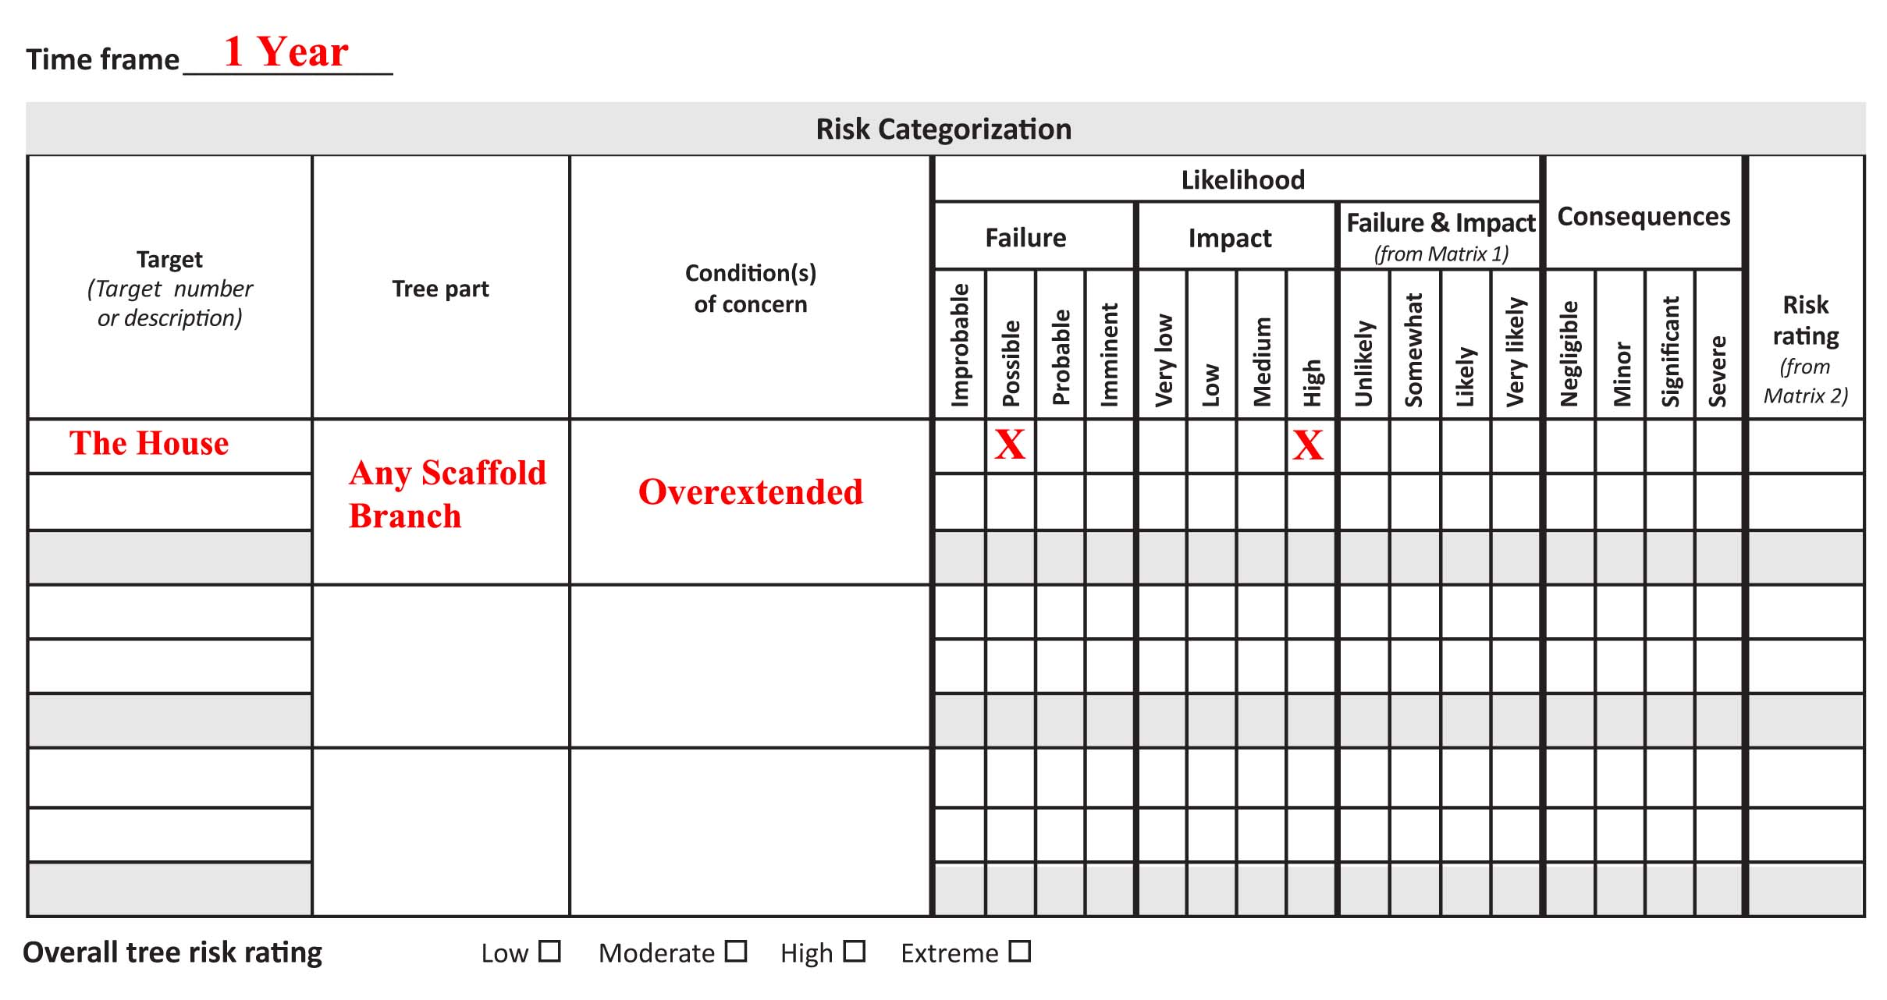
Splitting Tree Parts

Slide 49
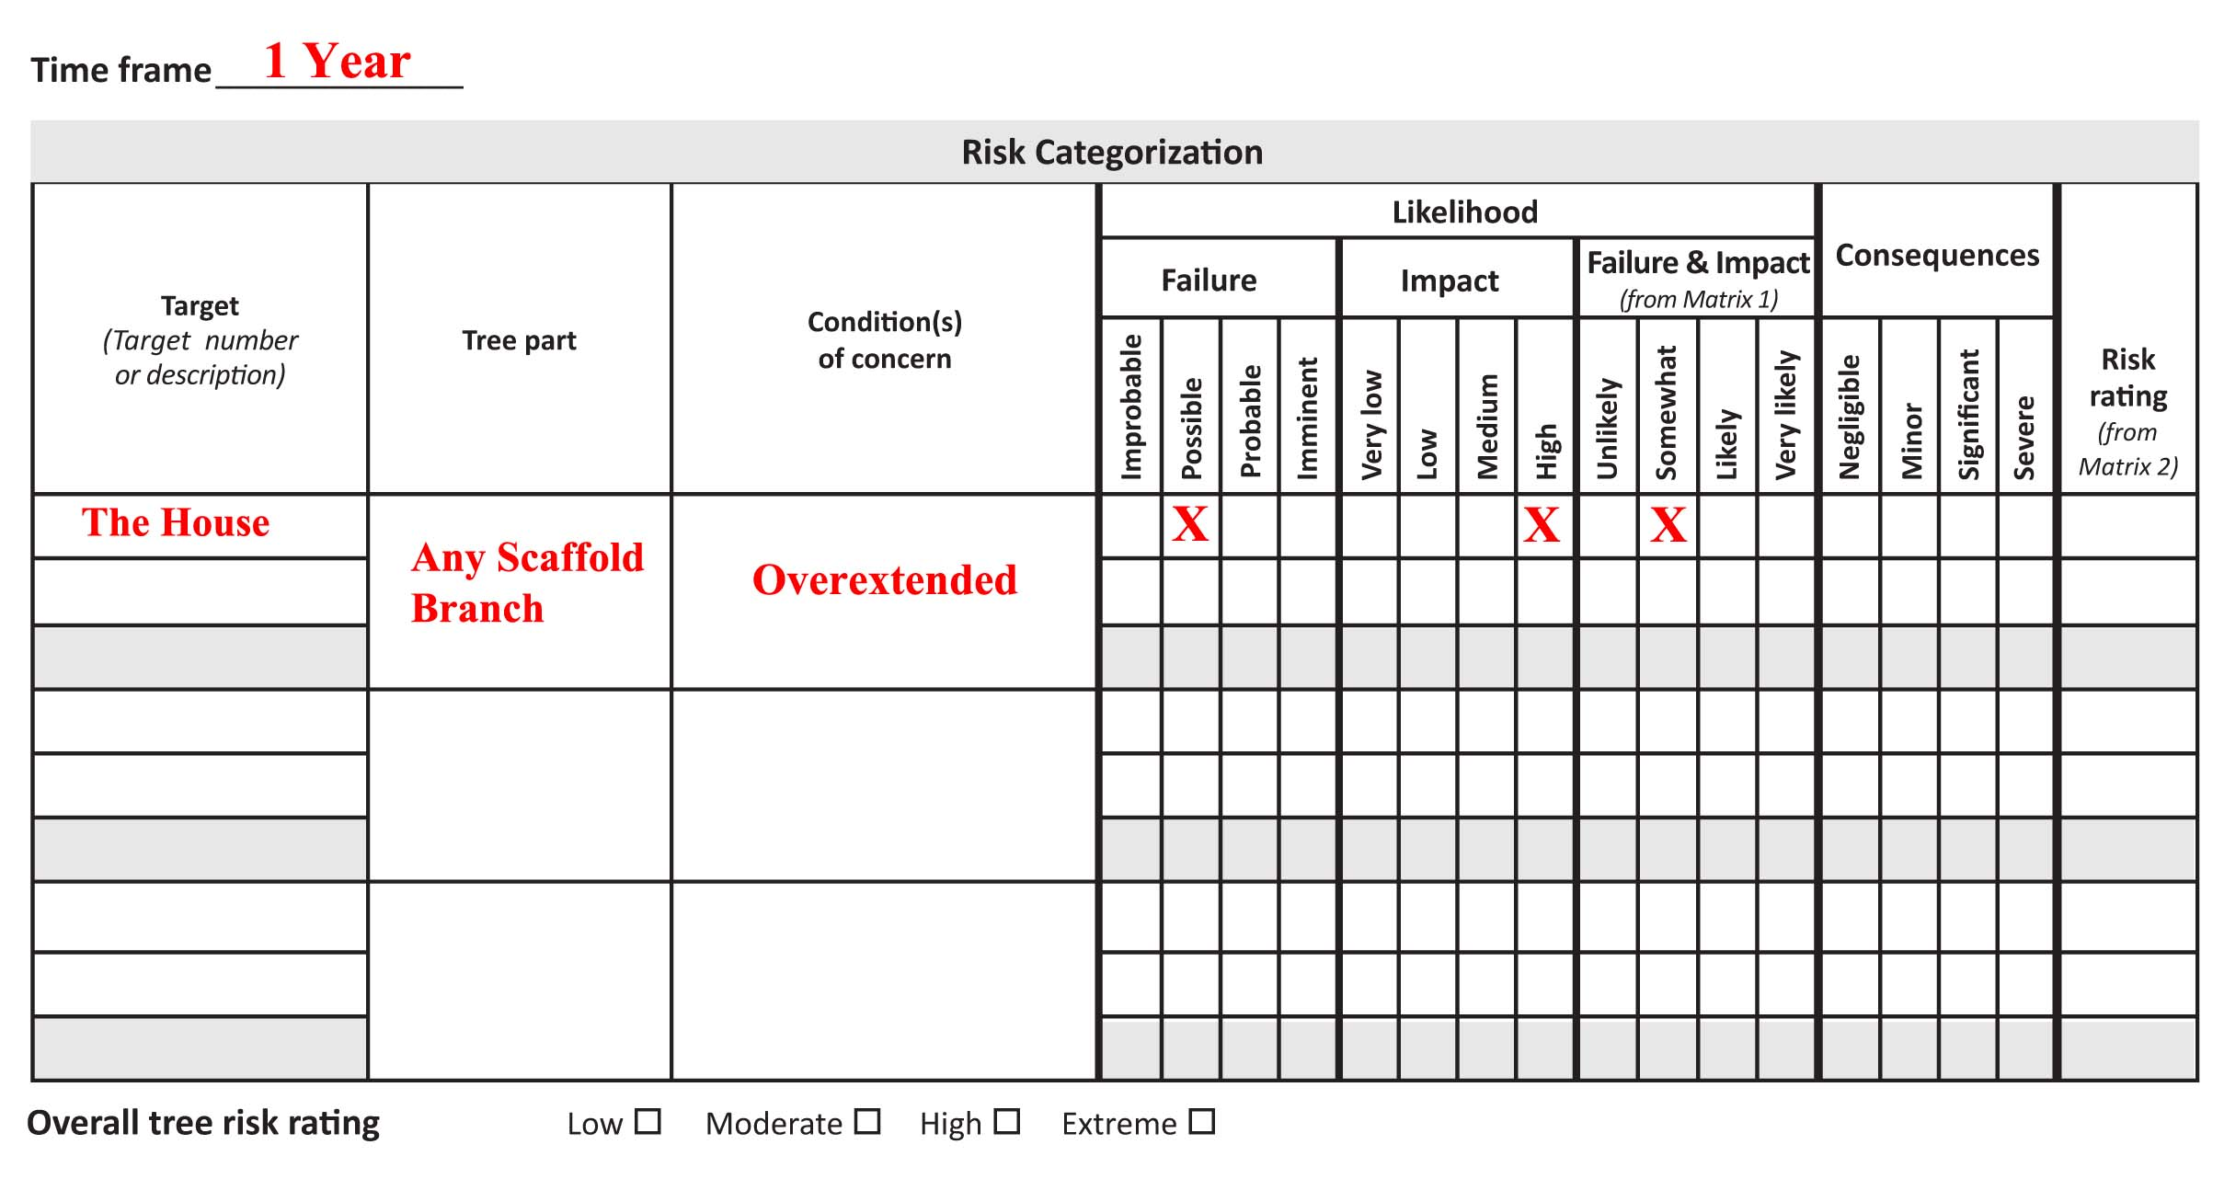
Splitting Tree Parts

Slide 50
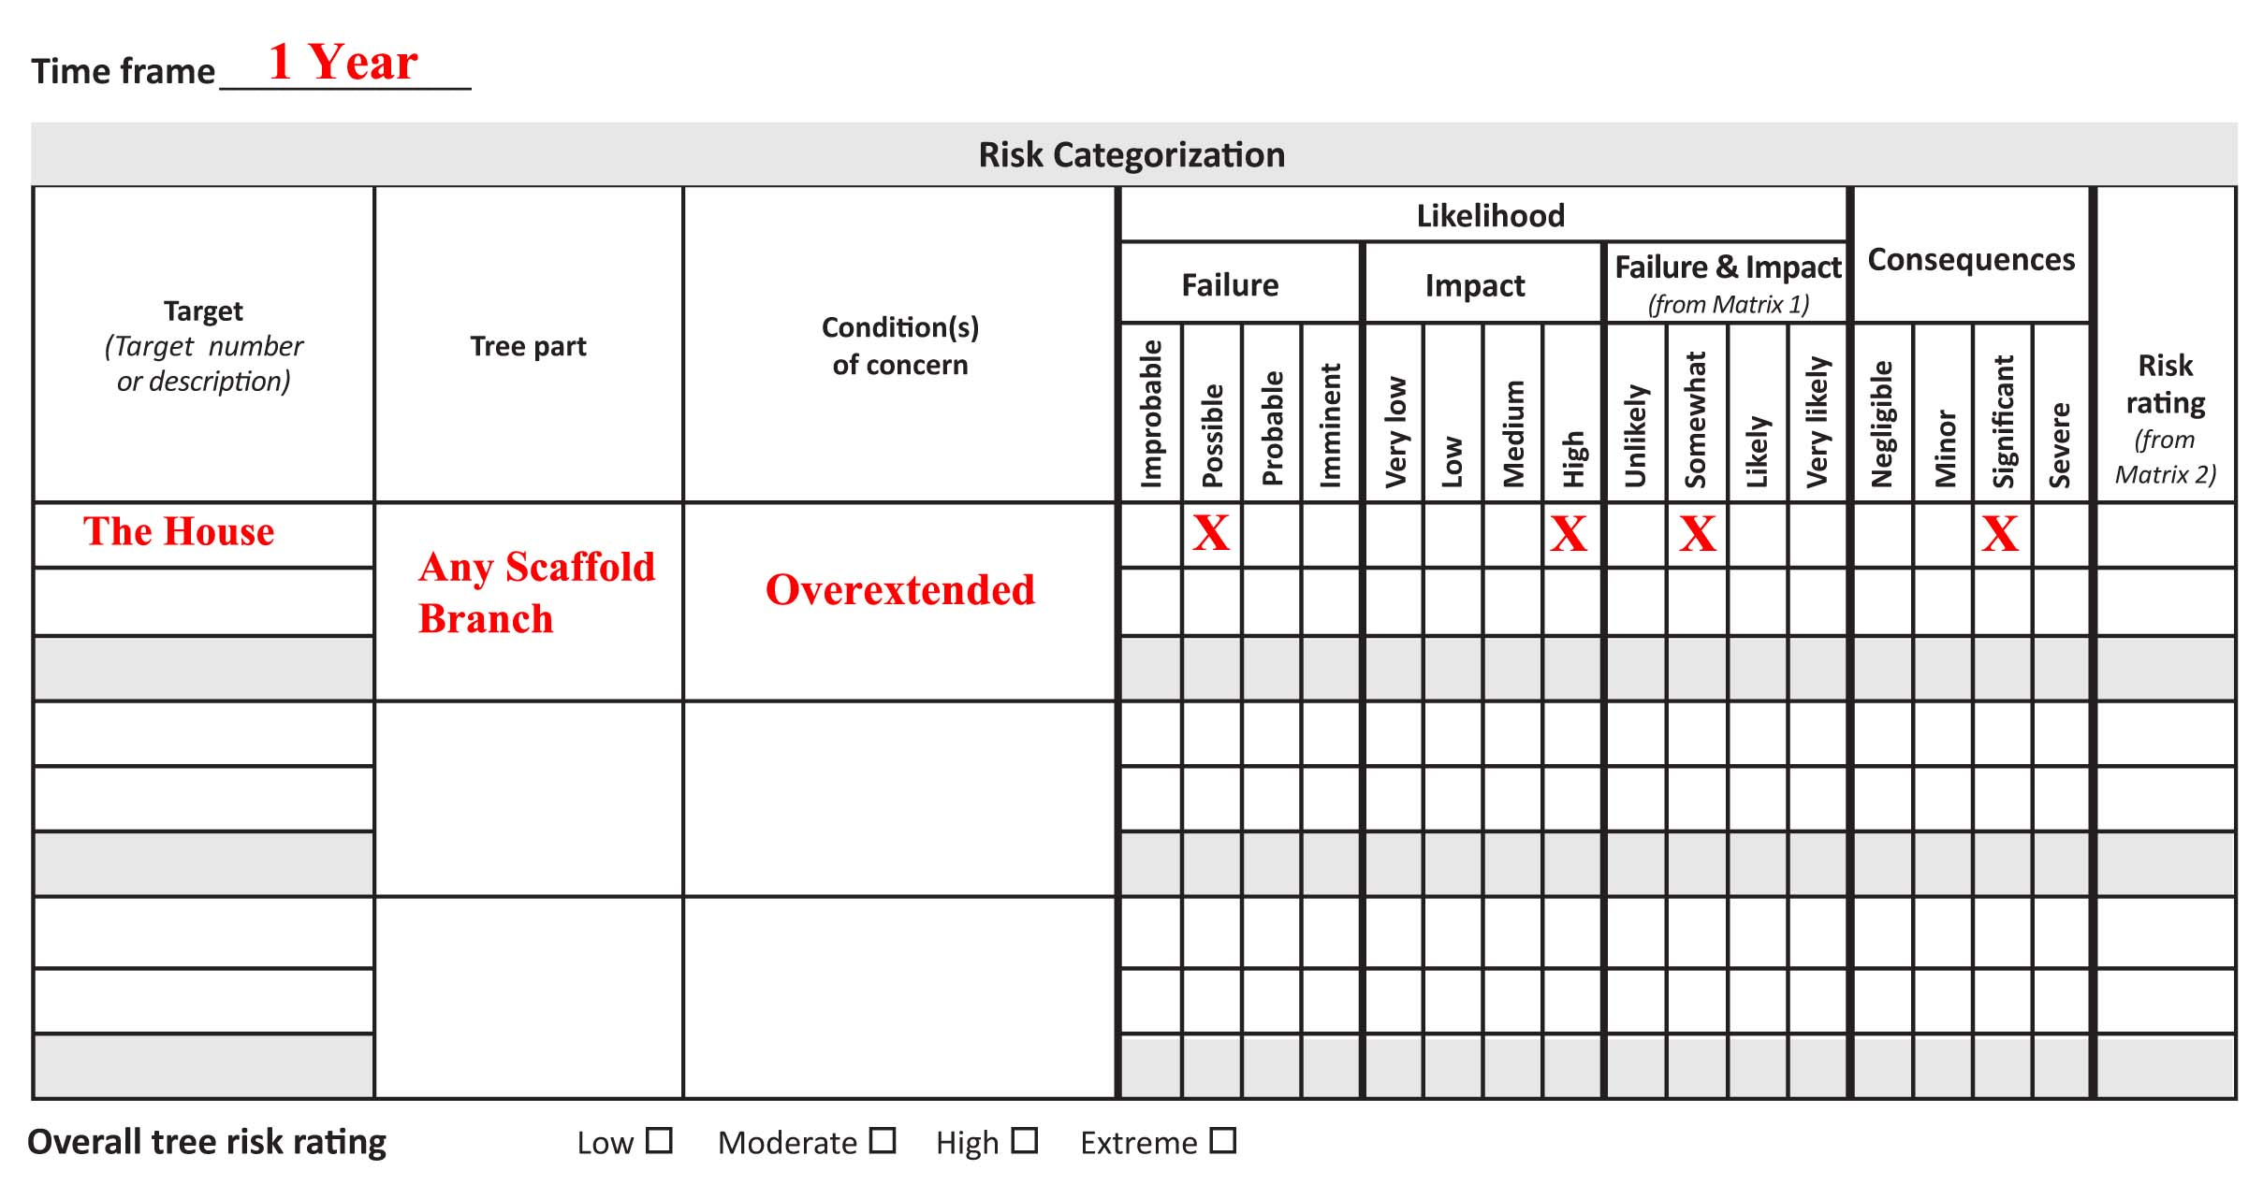
Splitting Tree Parts

Slide 51
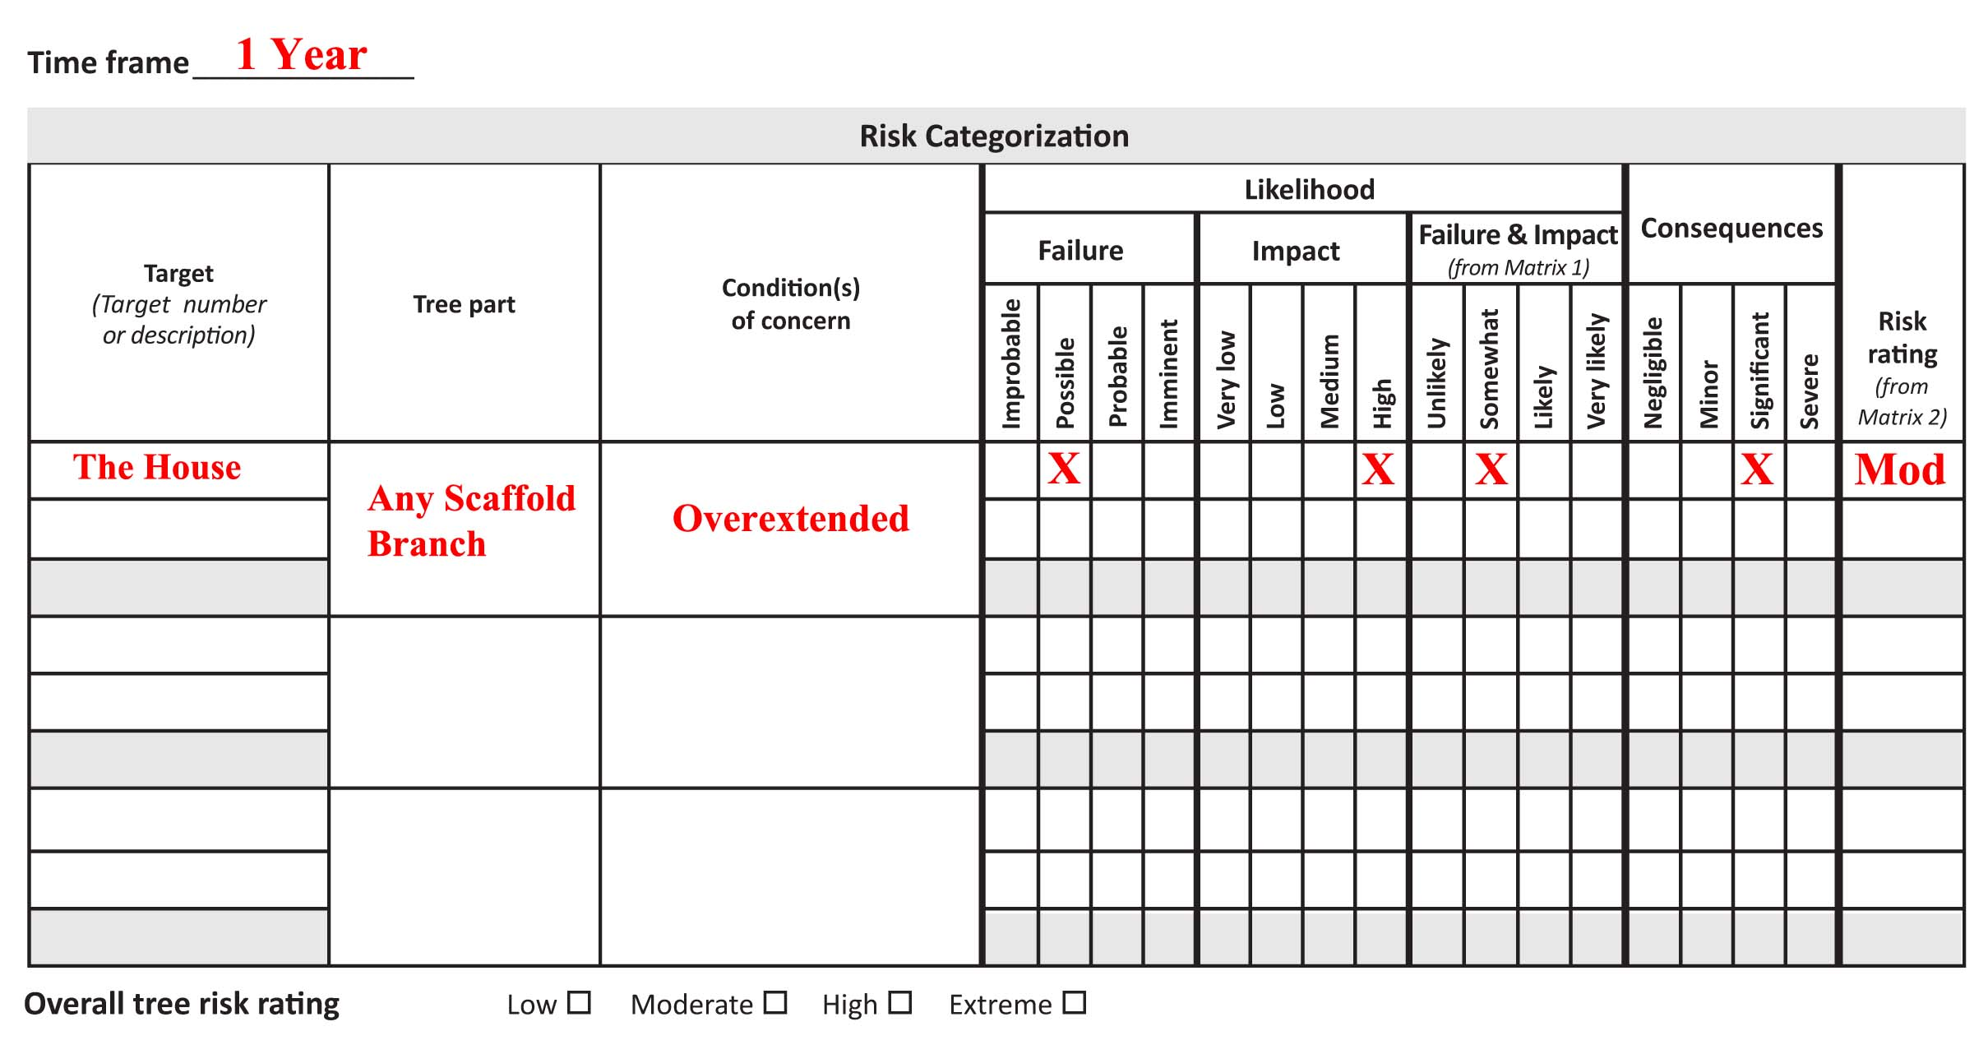
Splitting Tree Parts

Slide 52
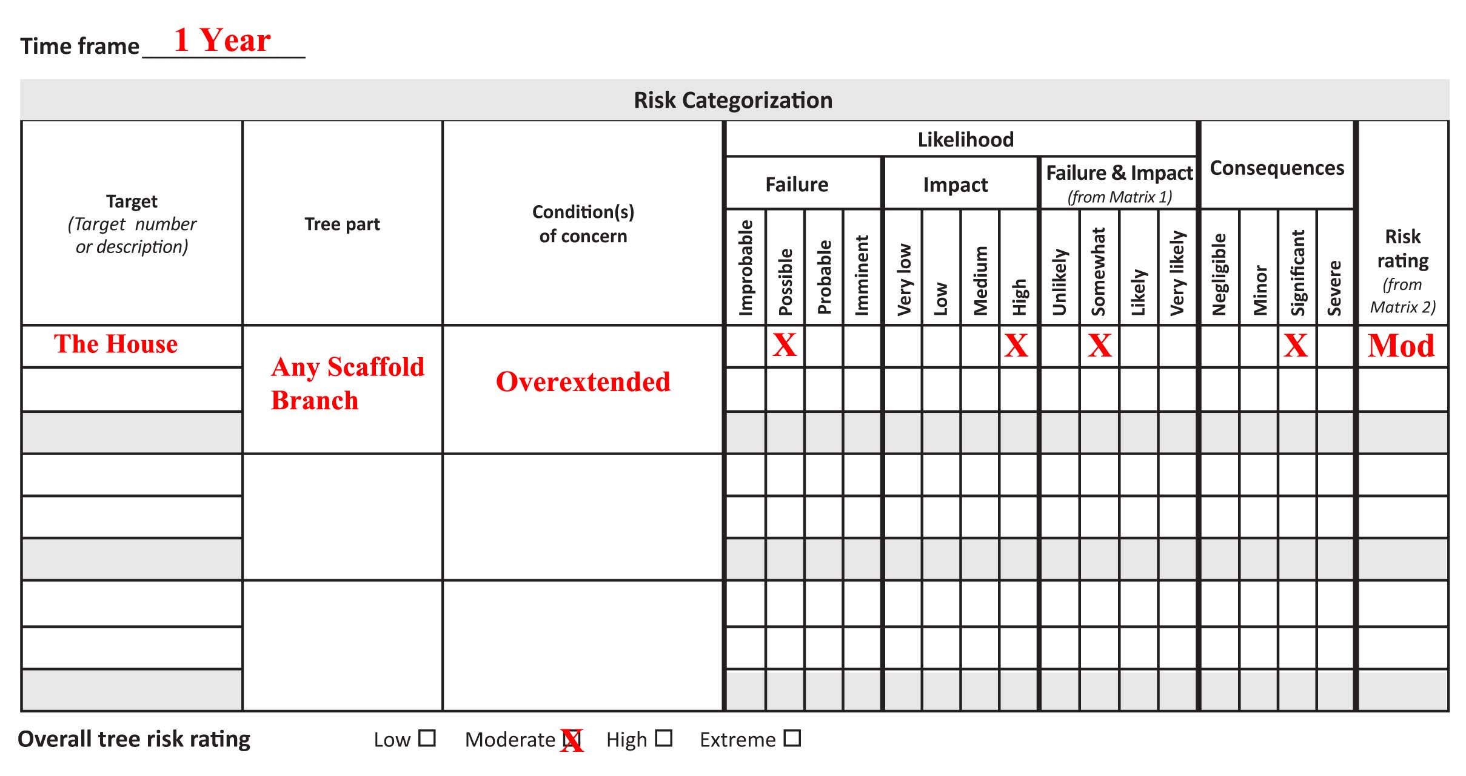
Splitting Tree Parts

Slide 53
Splitting Tree Parts
Possible
likelihood of Failure
Improbable
likelihood of Failure
Tree or tree part may fail in extreme weather conditions
It is unlikely to fail in normal weather conditions.
Tree or tree part is not likely to fail in normal weather conditions.
It may not fail even in extreme weather conditions.

Slide 54
Splitting Tree Parts
Quercus agrifolia
  Several large scaffold branches overextended over house
  If failure were to occur, likelihood of impact would be HIGH
  If impact were to occur, consequences would be SIGNIFICANT

Slide 55
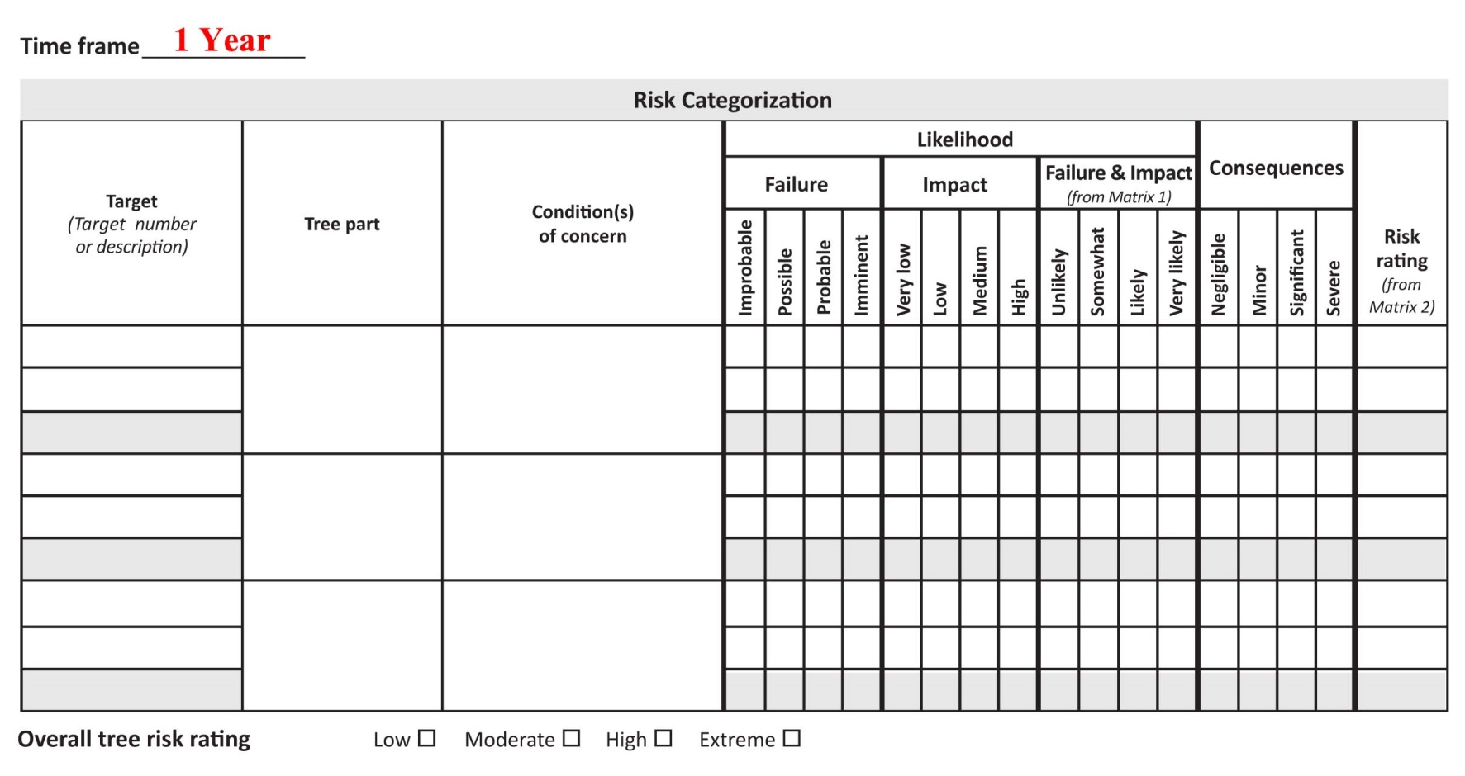
Splitting Tree Parts

Slide 56
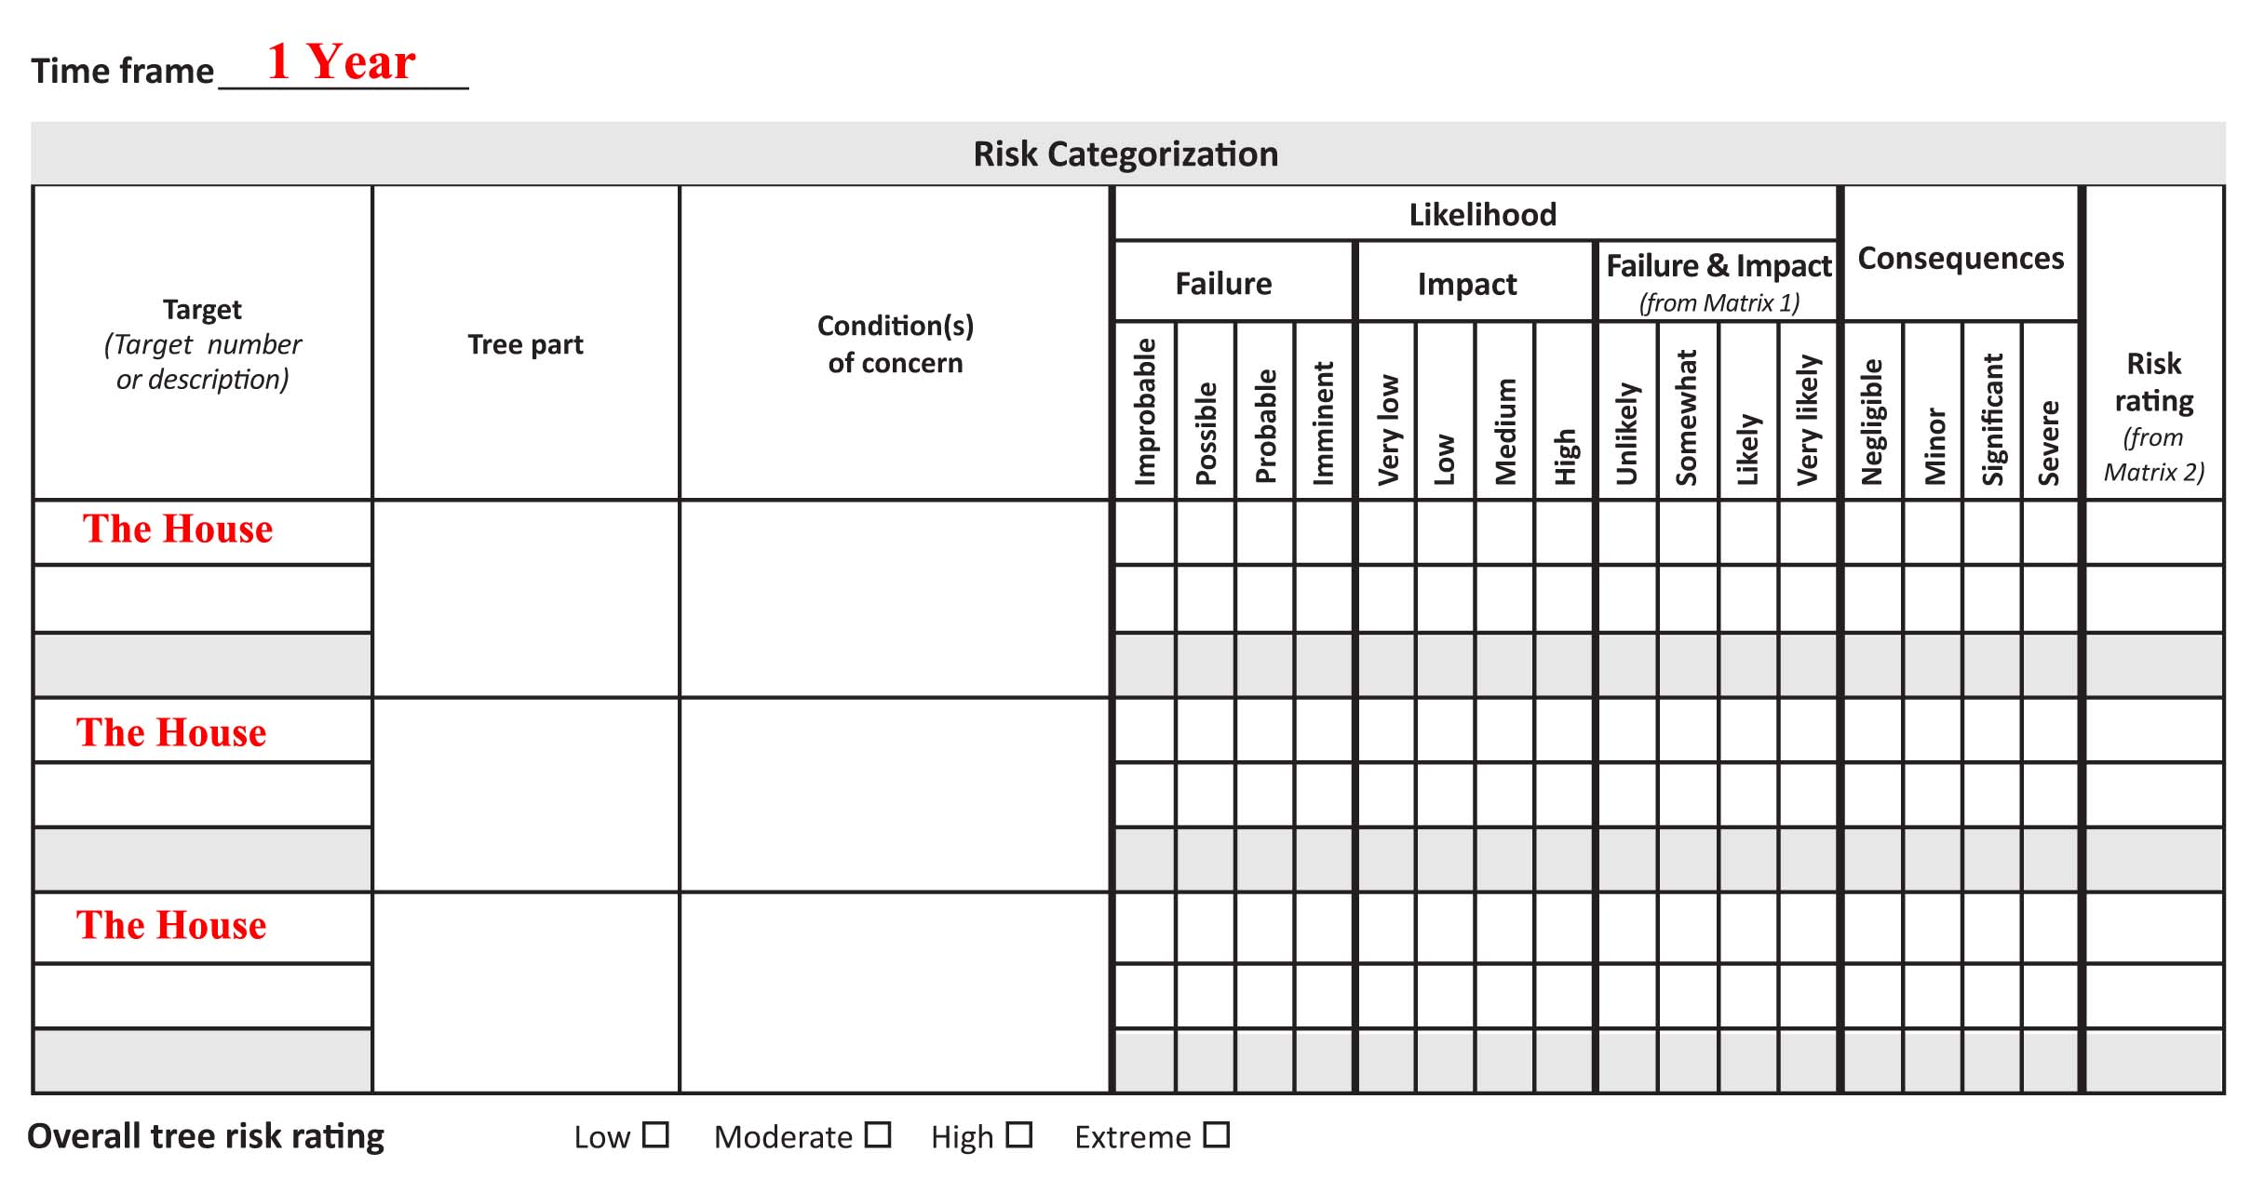
Splitting Tree Parts

Slide 57
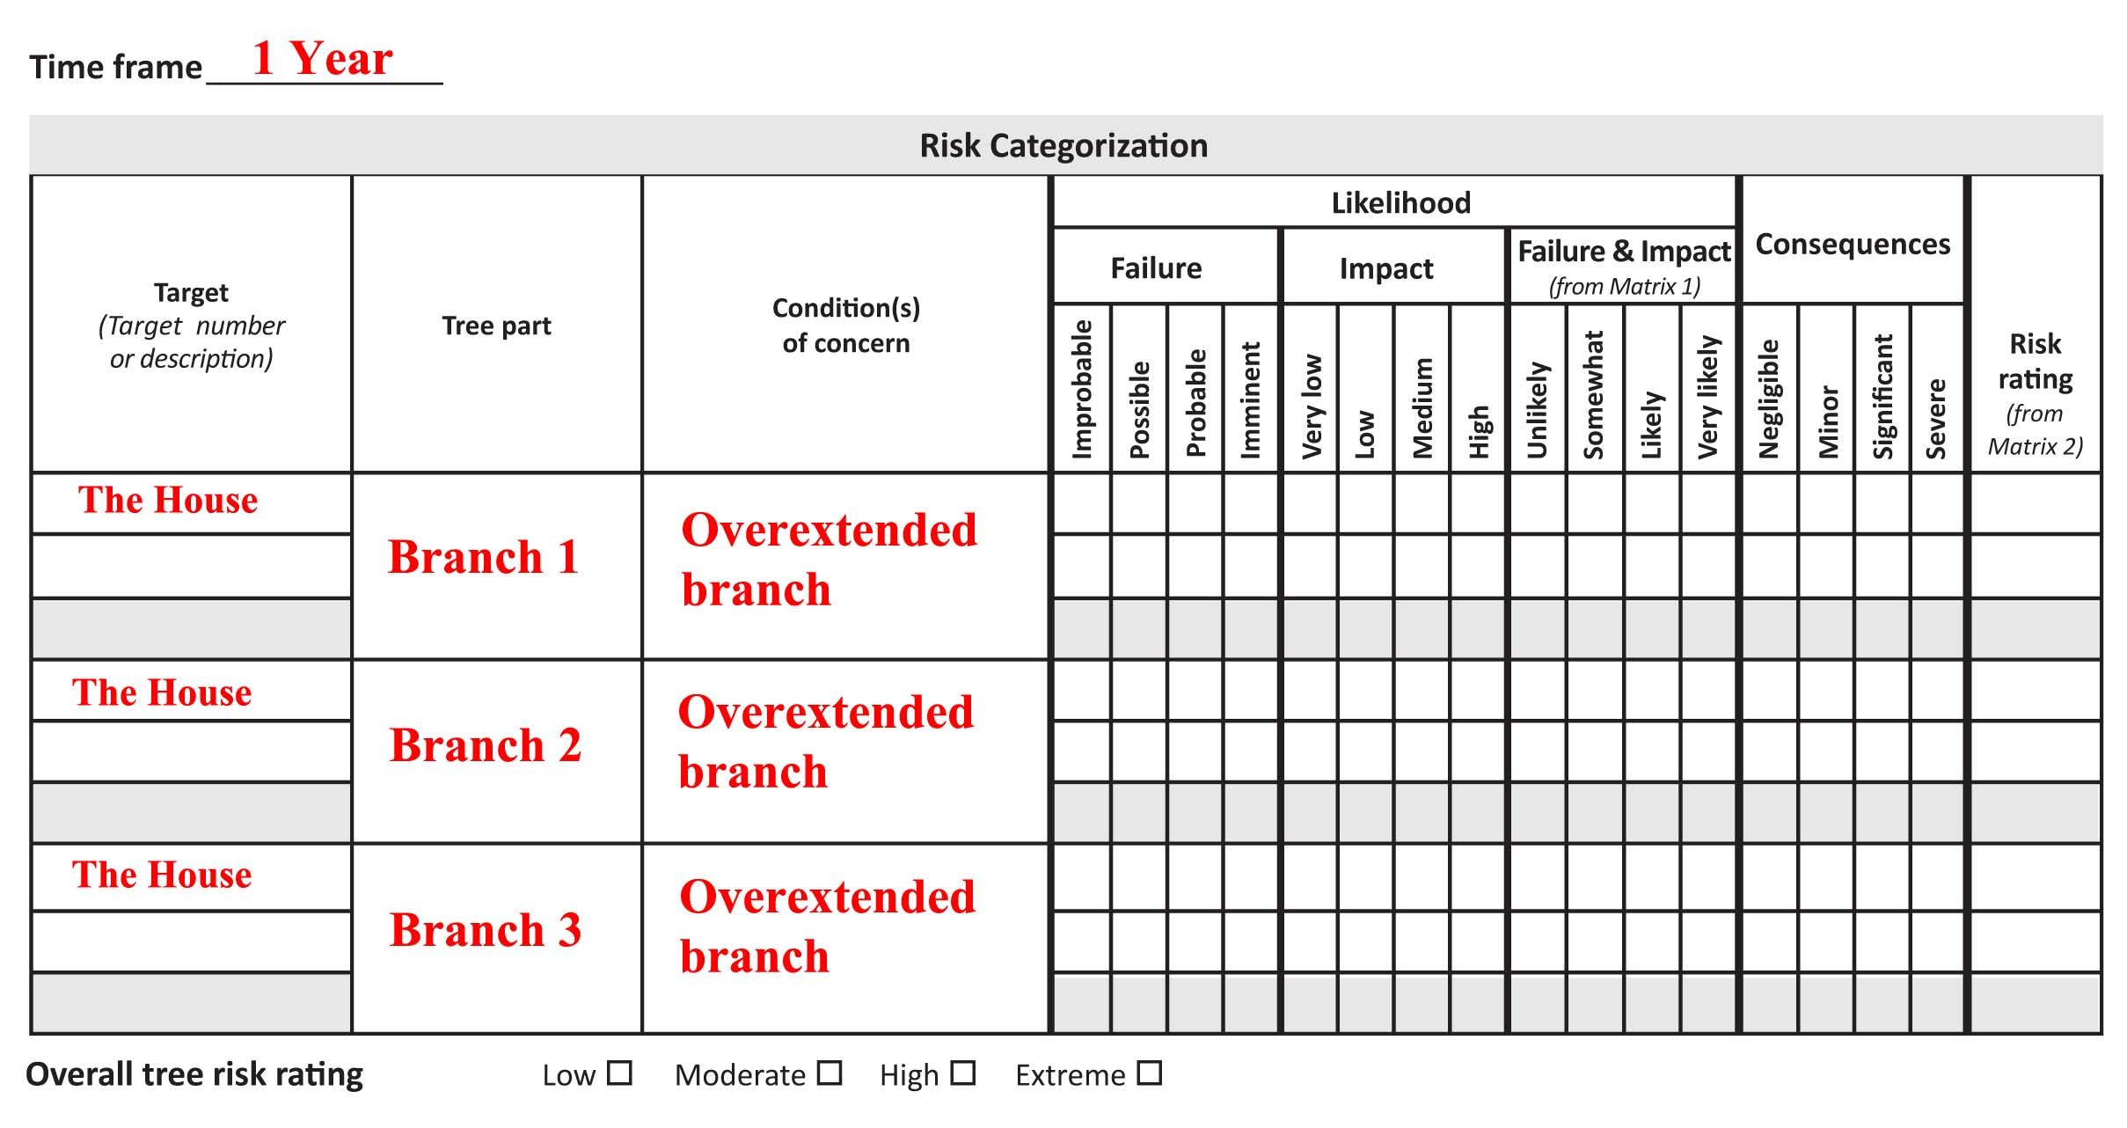
Splitting Tree Parts

Slide 58
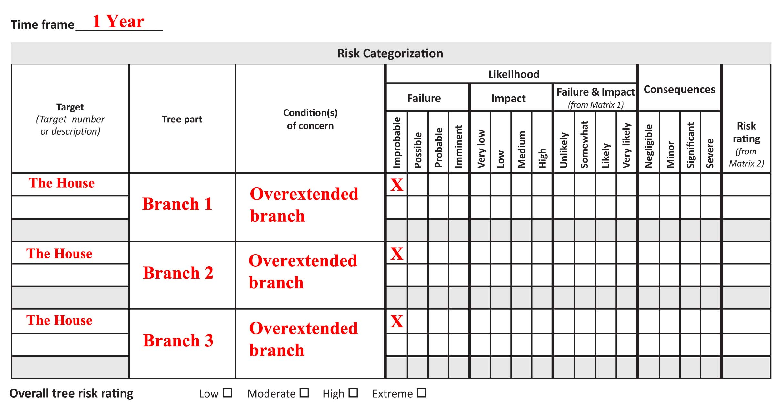
Splitting Tree Parts

Slide 59
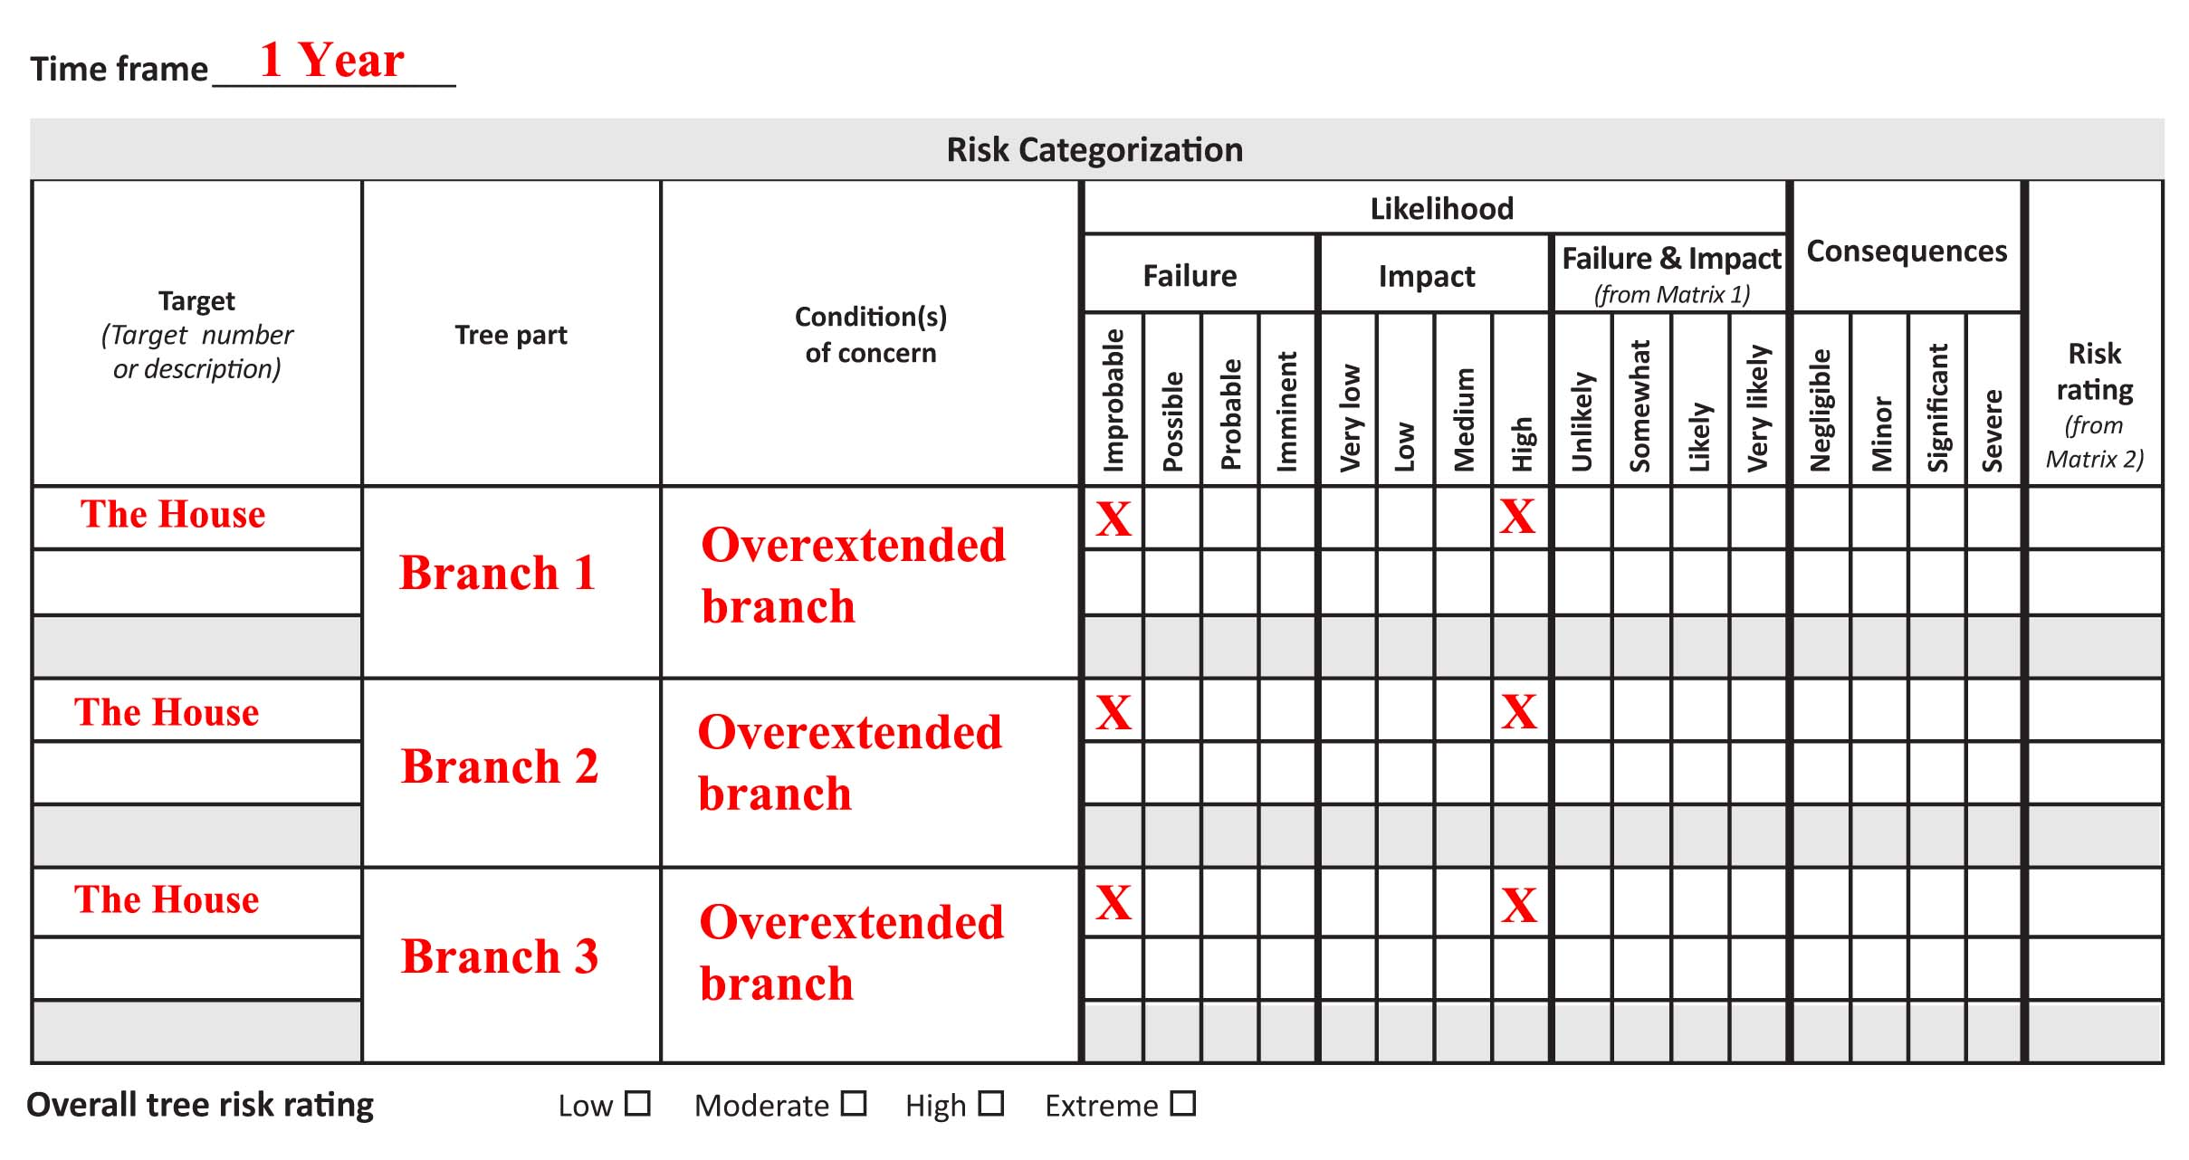
Splitting Tree Parts

Slide 60
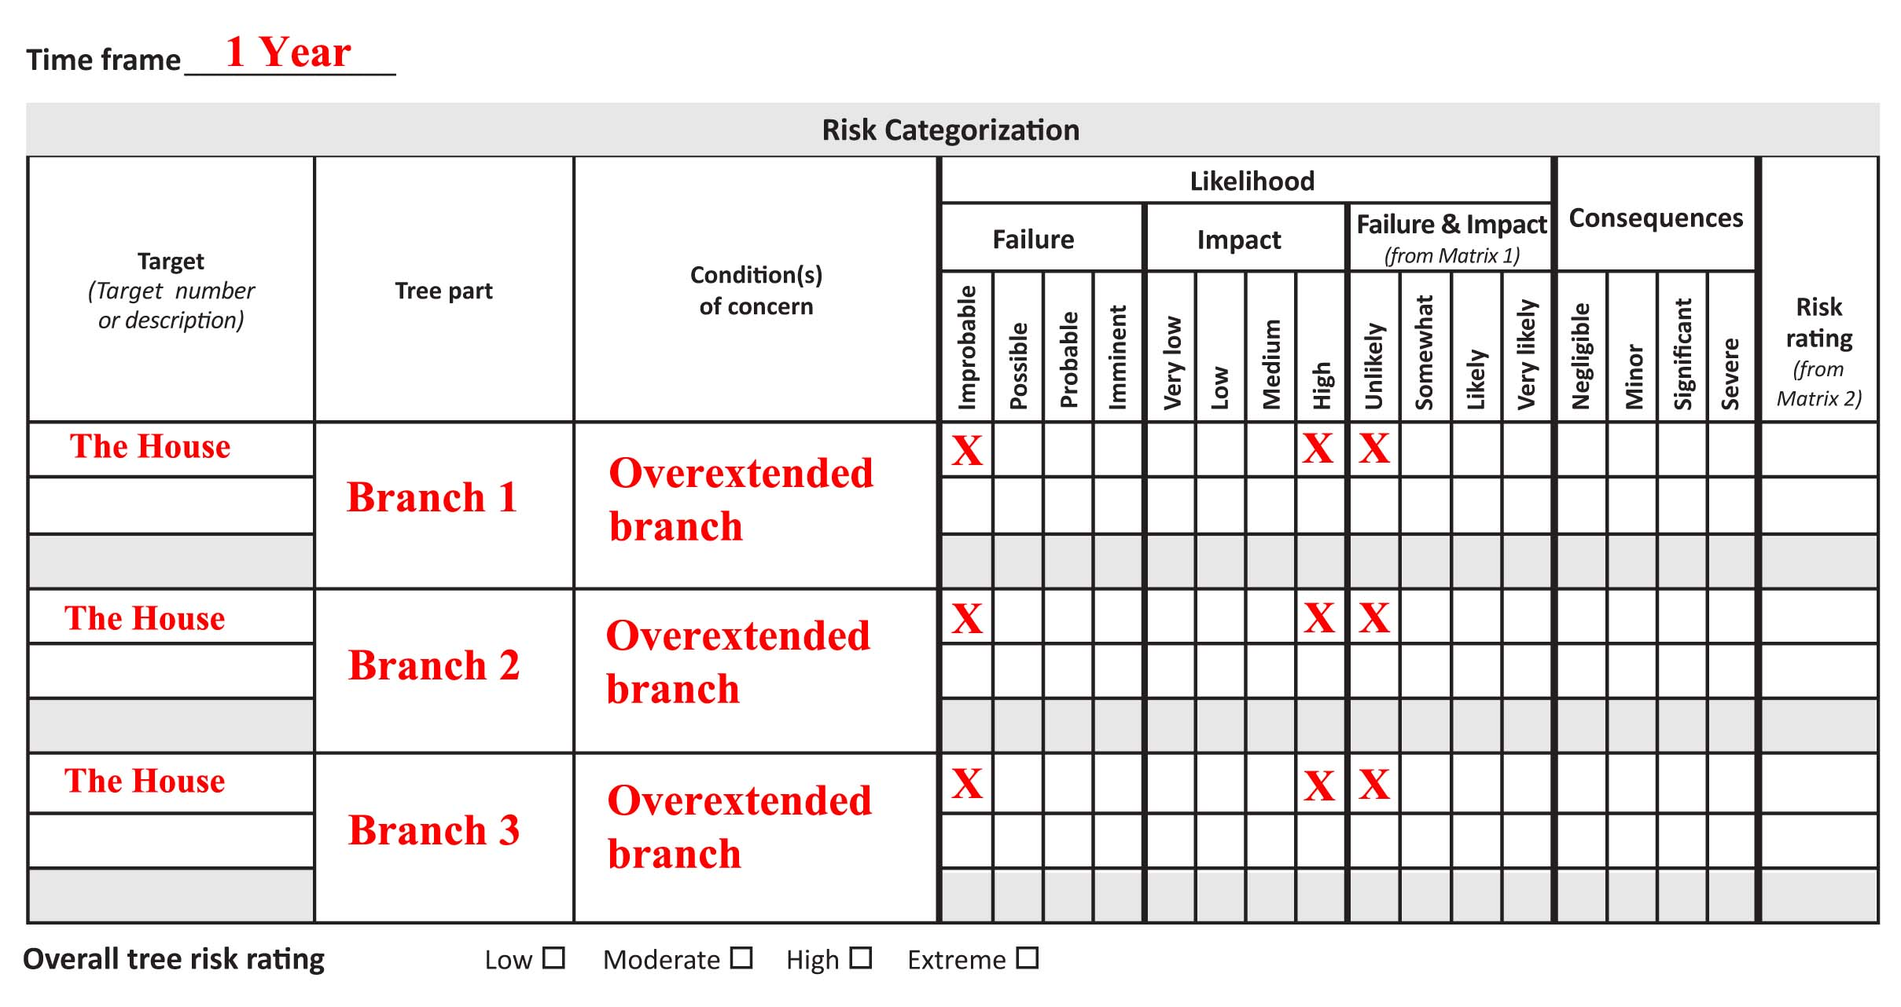
Splitting Tree Parts

Slide 61

Splitting Tree Parts

Slide 62
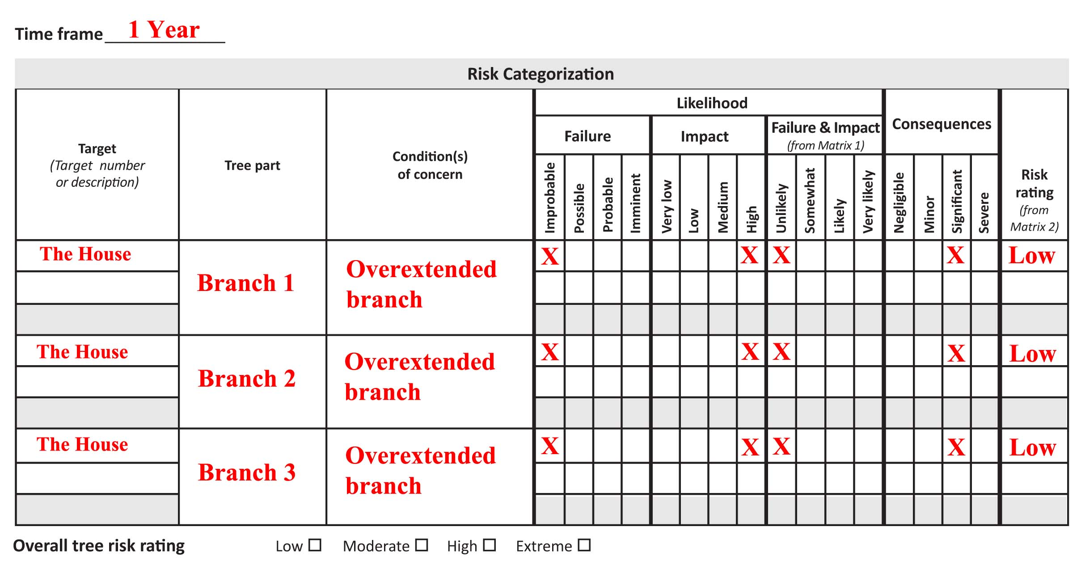
Splitting Tree Parts

Slide 63
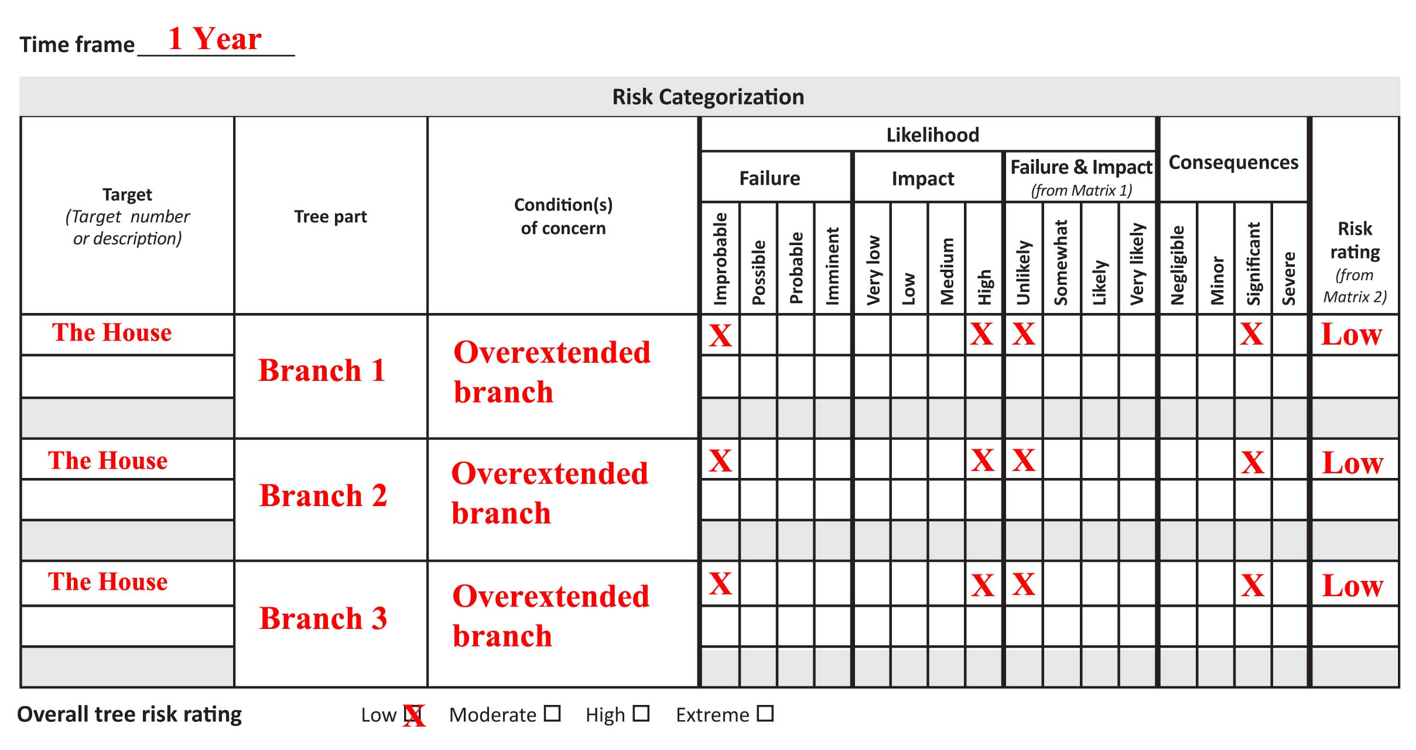
Splitting Tree Parts

Slide 64
Splitting Tree Parts
ANY Branch
  Overall Tree Risk: MODERATE
Branch 1, Branch 2, and Branch 3
  Overall Tree Risk: LOW

Slide 65
Splitting Tree Parts
Correlation Coefficient
  Positive Correlation
  If a storm is bad enough to make Branch 1 fail, then Branches 2 and 3 are more likely to fail

Slide 66
Splitting Tree Parts
Correlation Coefficient
  Likelihood of failure of Branch 1:
  IMPROBABLE
  Likelihood of failure of Branch 2:
  IMPROBABLE
  Likelihood of failure of Branch 3:
  IMPROBABLE
  Likelihood of failure of ANY Branch:
  POSSIBLE

Slide 67
Splitting Tree Parts
Correlation Coefficient
  Likelihood of ANY branch failing is greater than likelihood of ONE SPECIFIC branch failing

Slide 68
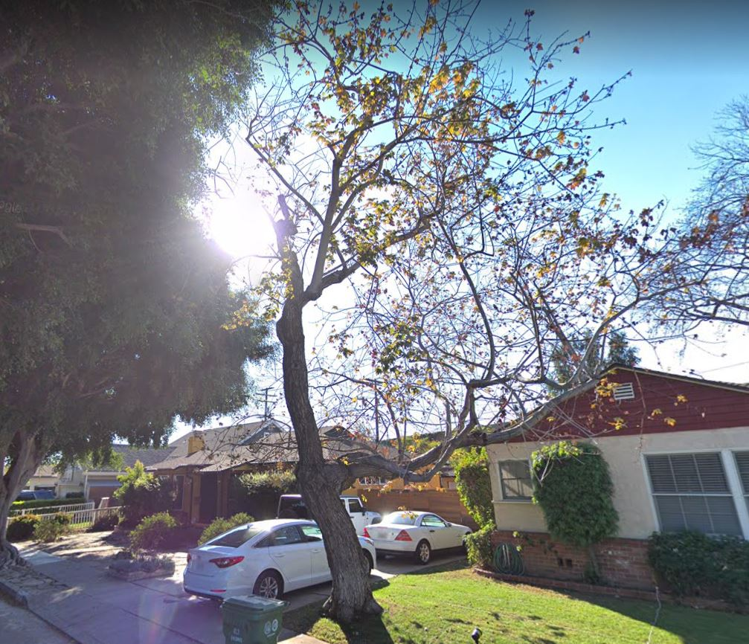
Modifying Time Frame
Acer saccharinum
  Growing in heavily irrigated lawn
  Hollow trunk when sounded
  Observed fungal fruiting bodies at root crown

Slide 69
Modifying Time Frame
Acer saccharinum
  Growing in heavily irrigated lawn
  Hollow trunk when sounded
  Observed fungal fruiting bodies at root crown
  Street and driveway have frequent occupancy of parked vehicles

Slide 70
Modifying Time Frame
Acer saccharinum
  Growing in heavily irrigated lawn
  Hollow trunk when sounded
  Observed fungal fruiting bodies at root crown
  Street and driveway have frequent occupancy of parked vehicles
  Neighbors have complained about risk posed by tree

Slide 71
Modifying Time Frame

Slide 72

Modifying Time Frame

Slide 73
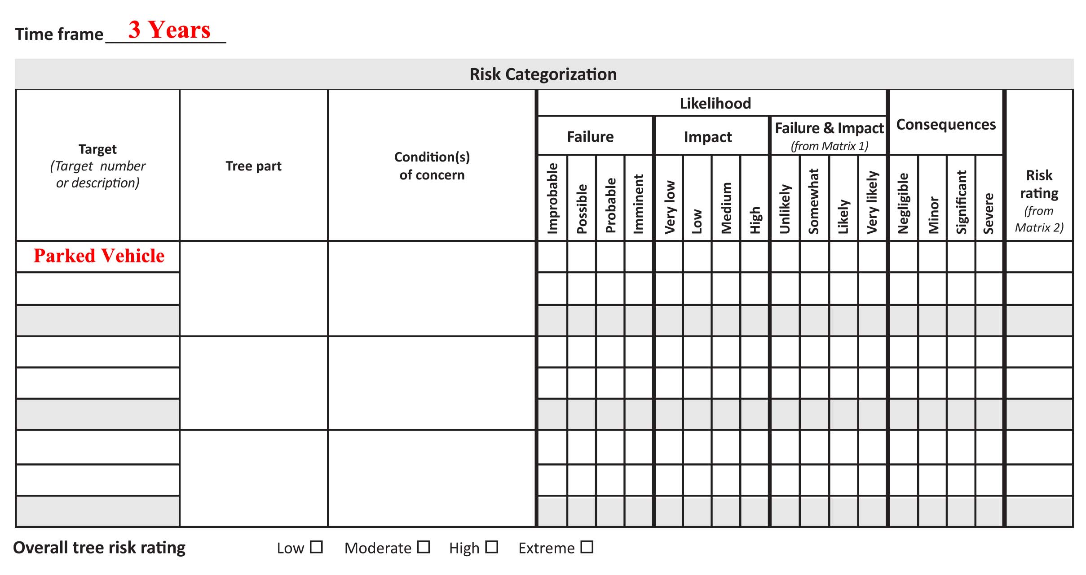
Modifying Time Frame

Slide 74

Modifying Time Frame

Slide 75
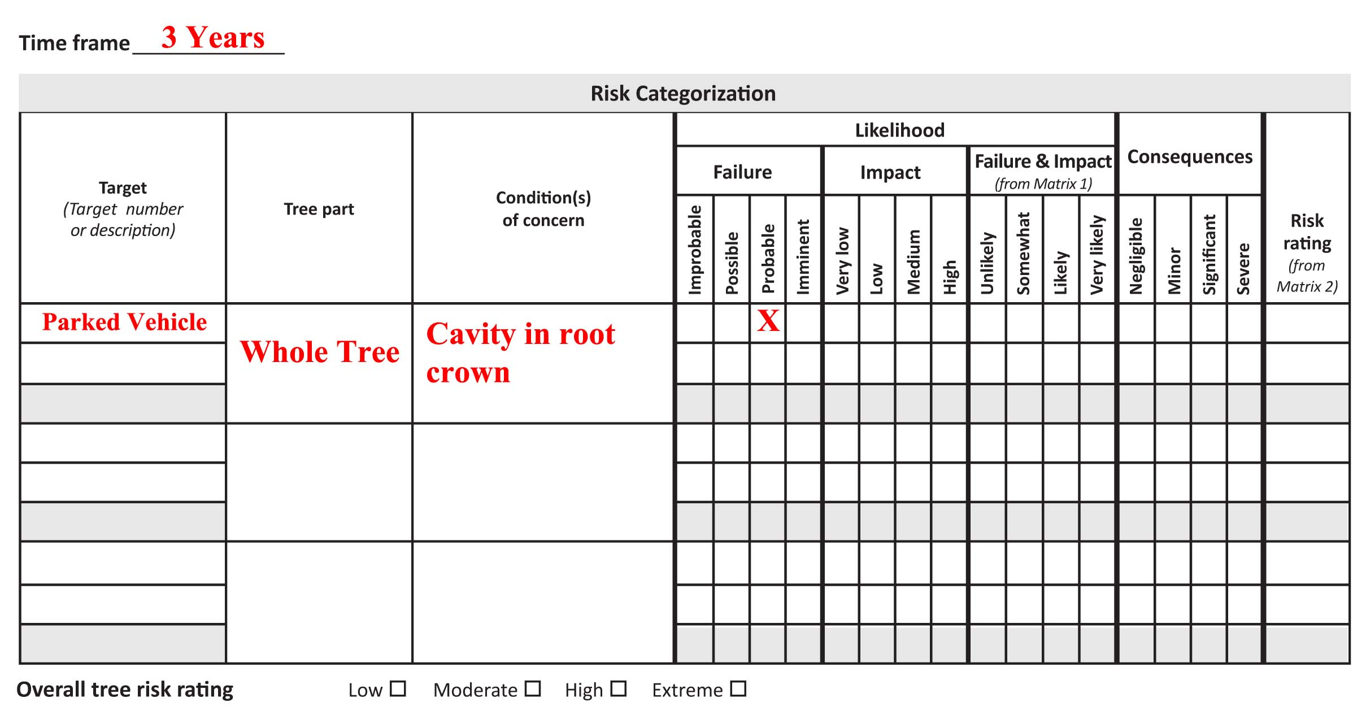
Modifying Time Frame

Slide 76
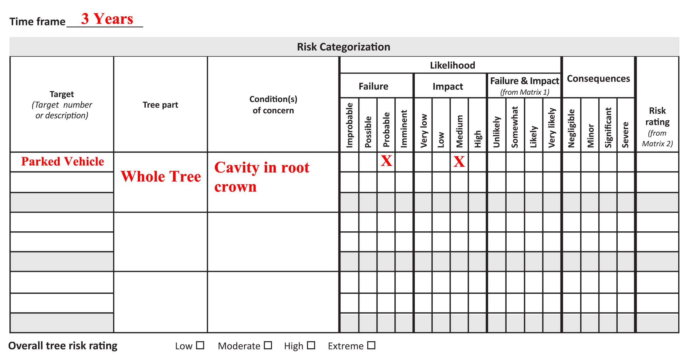
Modifying Time Frame

Slide 77

Modifying Time Frame

Slide 78

Modifying Time Frame

Slide 79
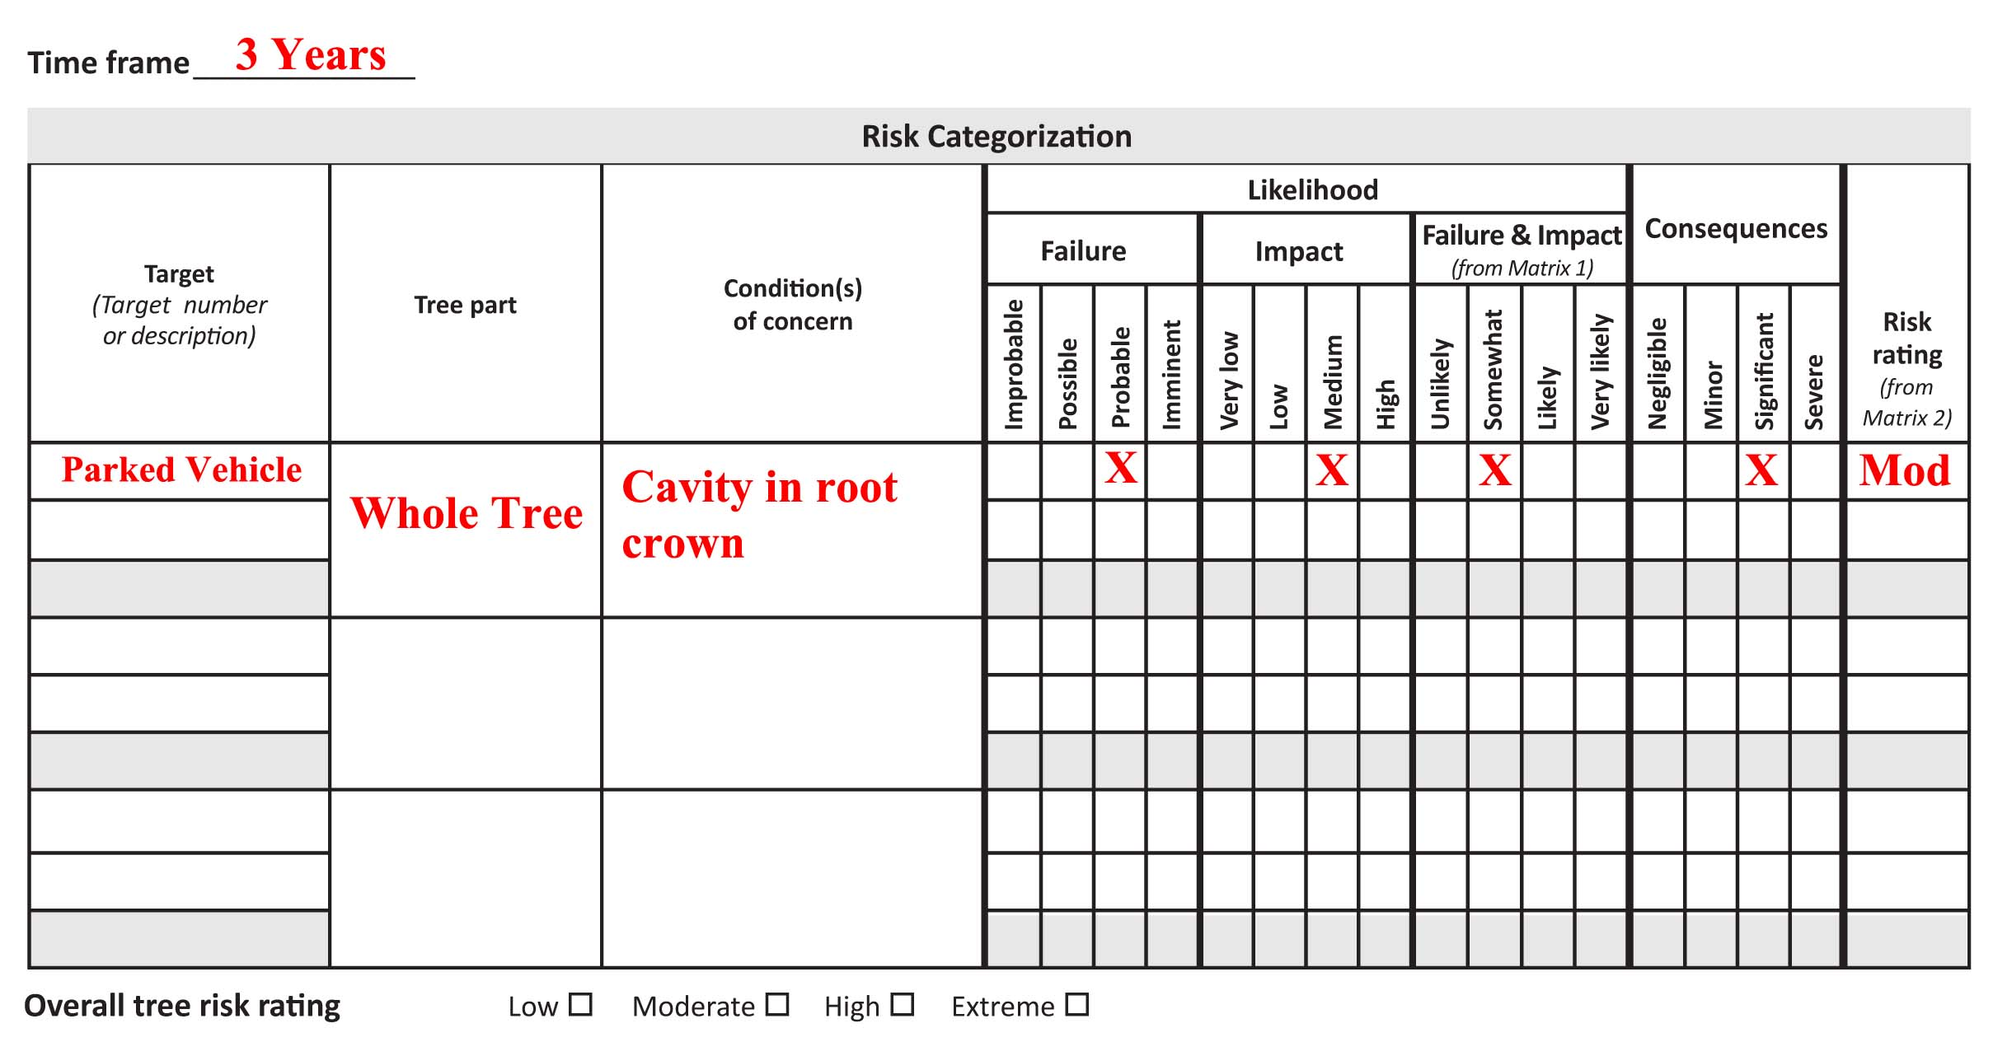
Modifying Time Frame

Slide 80
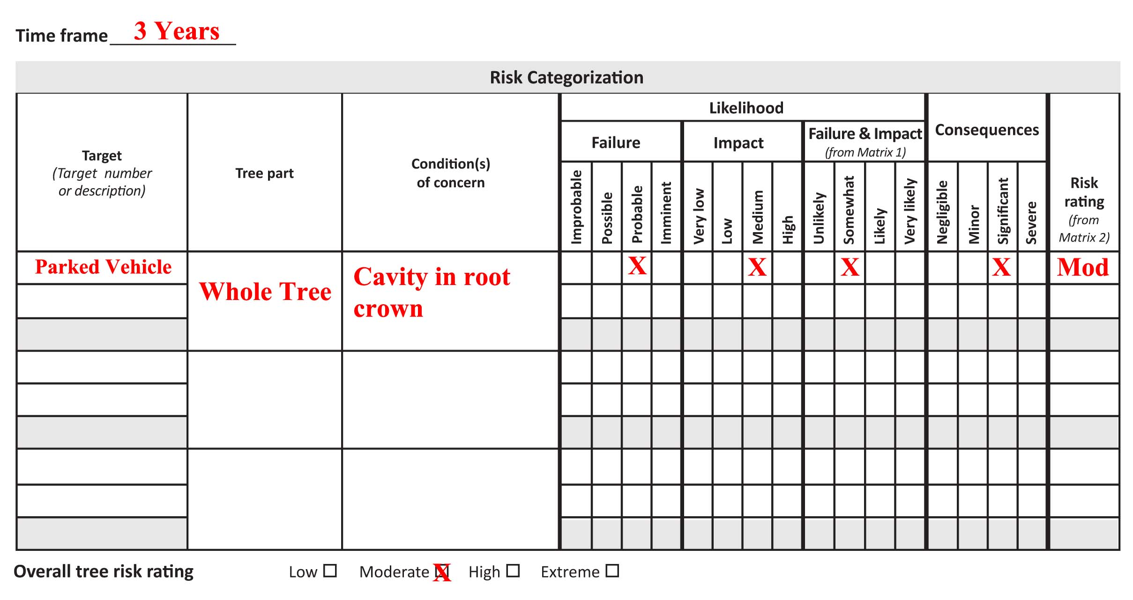
Modifying Time Frame

Slide 81
Modifying Time Frame
Acer saccharinum
  Growing in heavily irrigated lawn
  Hollow trunk when sounded
  Observed fungal fruiting bodies at root crown
  Street and driveway have frequent occupancy of parked vehicles
  Neighbors have complained about risk posed by tree

Slide 82
Modifying Time Frame

Slide 83
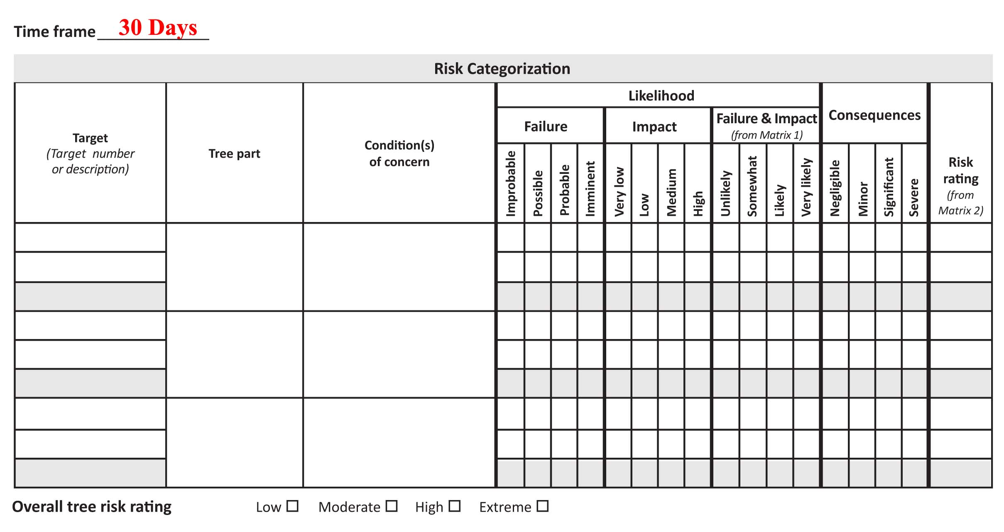
Modifying Time Frame

Slide 84
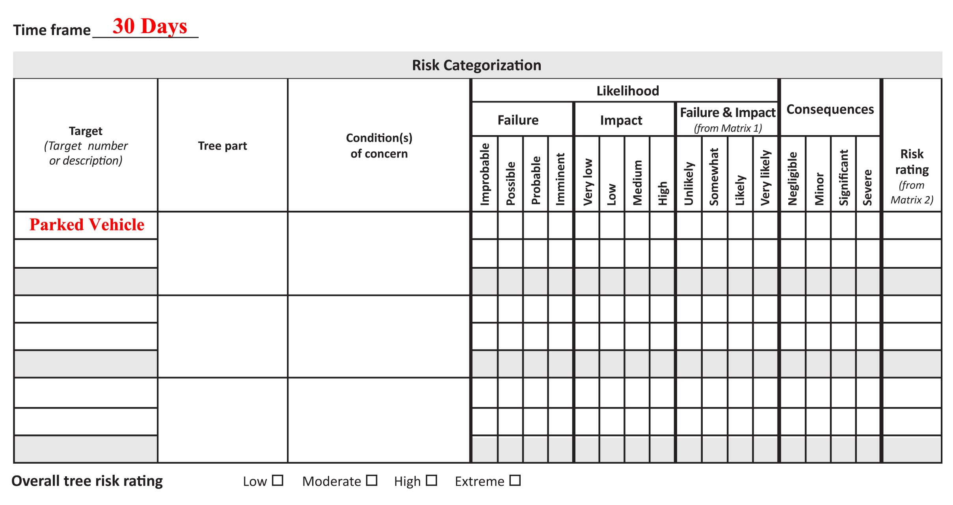
Modifying Time Frame

Slide 85
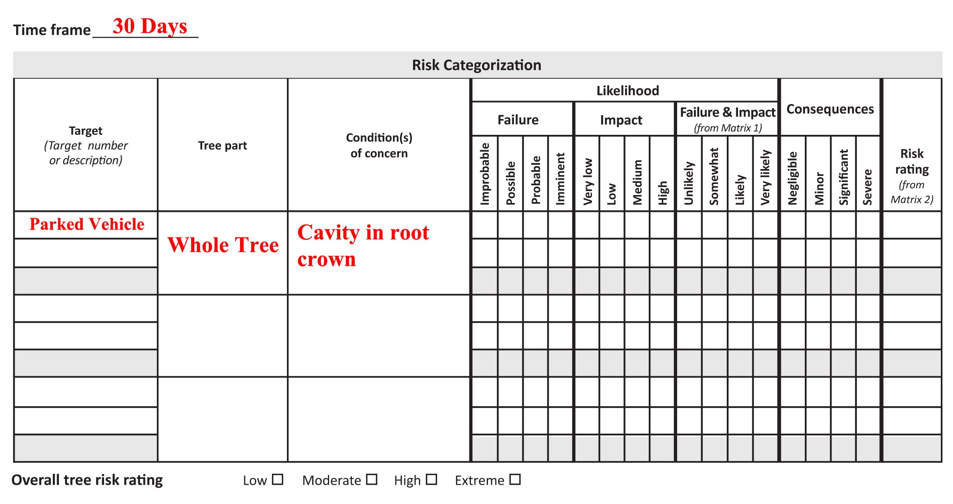
Modifying Time Frame

Slide 86

Modifying Time Frame

Slide 87

Modifying Time Frame

Slide 88

Modifying Time Frame

Slide 89

Modifying Time Frame

Slide 90

Modifying Time Frame

Slide 91

Modifying Time Frame

Slide 92
Modifying Time Frame
Time Frame: 3 years
  Overall Tree Risk: MODERATE
Time Frame: 30 days
  Overall Tree Risk: LOW

Slide 93

Modifying Time Frame
Quercus agrifolia
  Growing in natural form
  Ample response growth
  Extends over house

Slide 94
Modifying Time Frame
Quercus agrifolia
  Growing in natural form
  Ample response growth
  Extends over house
  Protected by municipal ordinance (bylaw)
  Developer wants to remove it

Slide 95
Modifying Time Frame

Slide 96
Modifying Time Frame

Slide 97

Modifying Time Frame

Slide 98

Modifying Time Frame

Slide 99

Modifying Time Frame

Slide 100

Modifying Time Frame

Slide 101

Modifying Time Frame

Slide 102

Modifying Time Frame

Slide 103

Modifying Time Frame

Slide 104

Modifying Time Frame

Slide 105
Modifying Time Frame
Quercus agrifolia
  Growing in natural form
  Ample response growth
  Extends over house
  Protected by municipal ordinance (bylaw)
  Developer wants to remove it

Slide 106
Modifying Time Frame

Slide 107

Modifying Time Frame

Slide 108

Modifying Time Frame

Slide 109

Modifying Time Frame

Slide 110

Modifying Time Frame

Slide 111

Modifying Time Frame

Slide 112

Modifying Time Frame

Slide 113

Modifying Time Frame

Slide 114

Modifying Time Frame

Slide 115

Modifying Time Frame

Slide 116
Modifying Time Frame
Time Frame: 1 year
  Overall Tree Risk: LOW
Time Frame: 10 years
  Overall Tree Risk: MODERATE

Slide 117
Black Hat Hacking TRAQ
Splitting Targets
Splitting Tree Parts
Modifying Time Frame

Slide 118
White Hat Hacking TRAQ
Identify and justify time frame
Identify tree parts
Identify targets
Communicate each individual risk posed

Slide 119
White Hat Hacking TRAQ
NOT:
“The tree poses a high risk.”

Slide 120
White Hat Hacking TRAQ
Try this:
“The risk posed by whole tree failure striking a parked vehicle in the next three year time frame is high.”

Slide 121
White Hat Hacking TRAQ
Try this:
“The risk posed by whole tree failure striking a parked vehicle in the next three year time frame is high.”

Slide 122
White Hat Hacking
the
TRAQ Methodology
James Komen
jameskomen@gmail.com
1-703-439-0569

Slide 123

Tuesday, 7 August
2018 ISA Annual Conference
White Hat Hacking the TRAQ Methodology
  James Komen
Code: CF-18-077
0.75 A, T, L, M, Bm

